Slide 2
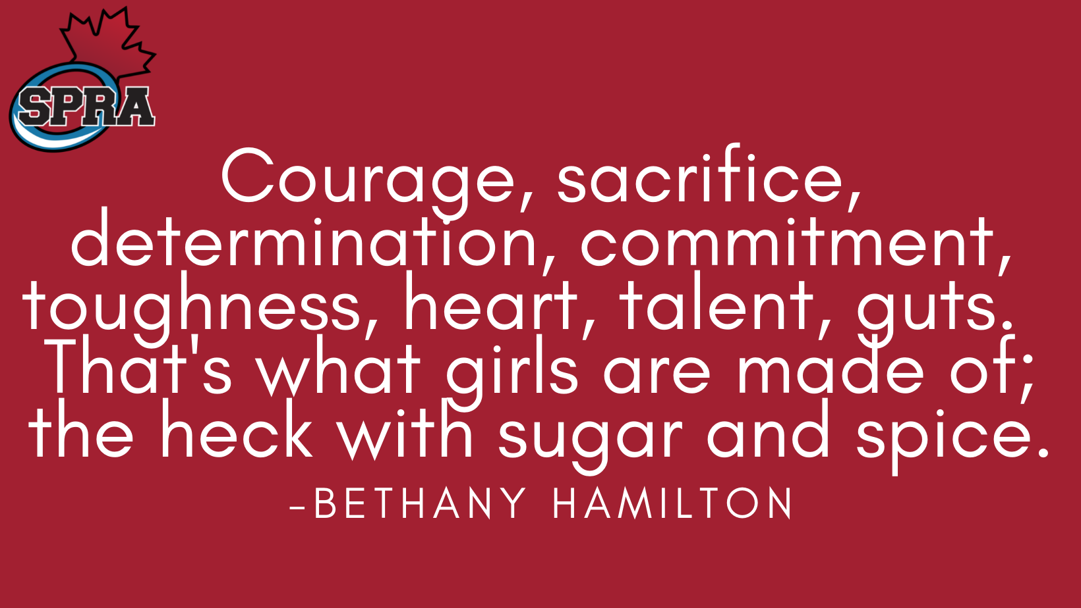

Slide 3
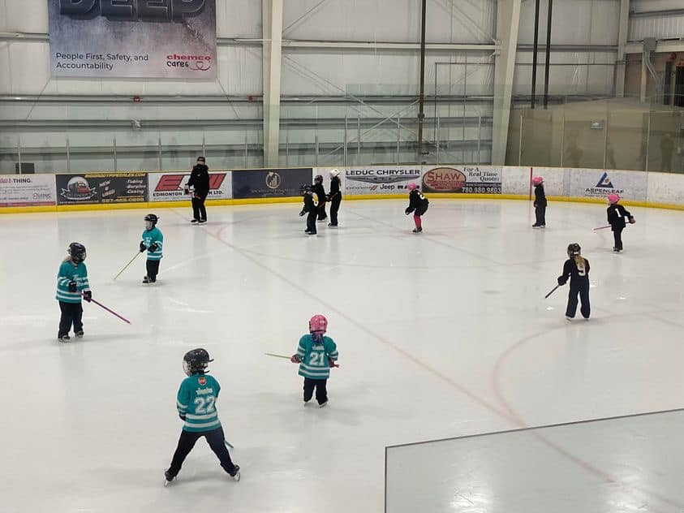
How
It
All
Begins….
*AS Panthers

Slide 4
Soooooo glad to be back for a more normal 21/22 season!!!

Slide 6
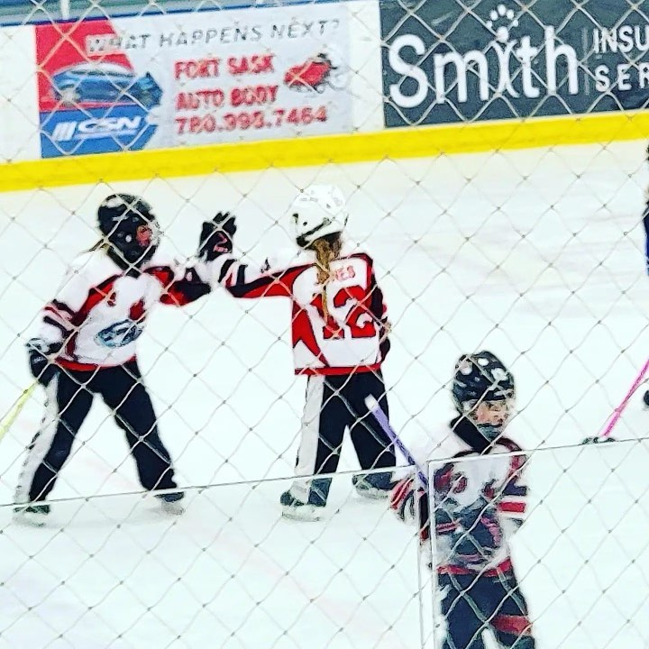
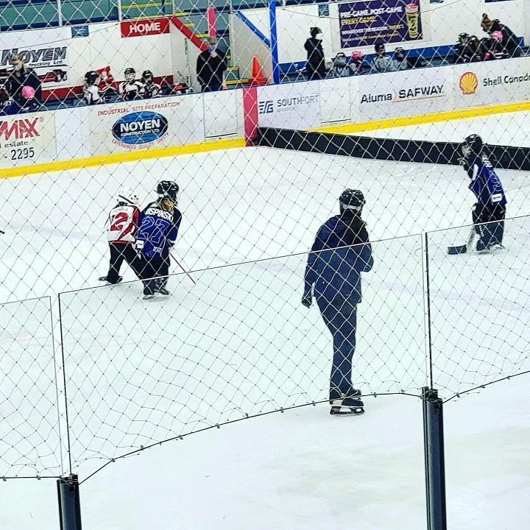
One of our Step 1 players got her first ever goal at the @fort_sask_ringette Diamond Ring tourney. She said, “well I crossed the line and they passed it to me, and I knew they were both behind me so I thought I better just go for it!”

Slide 7
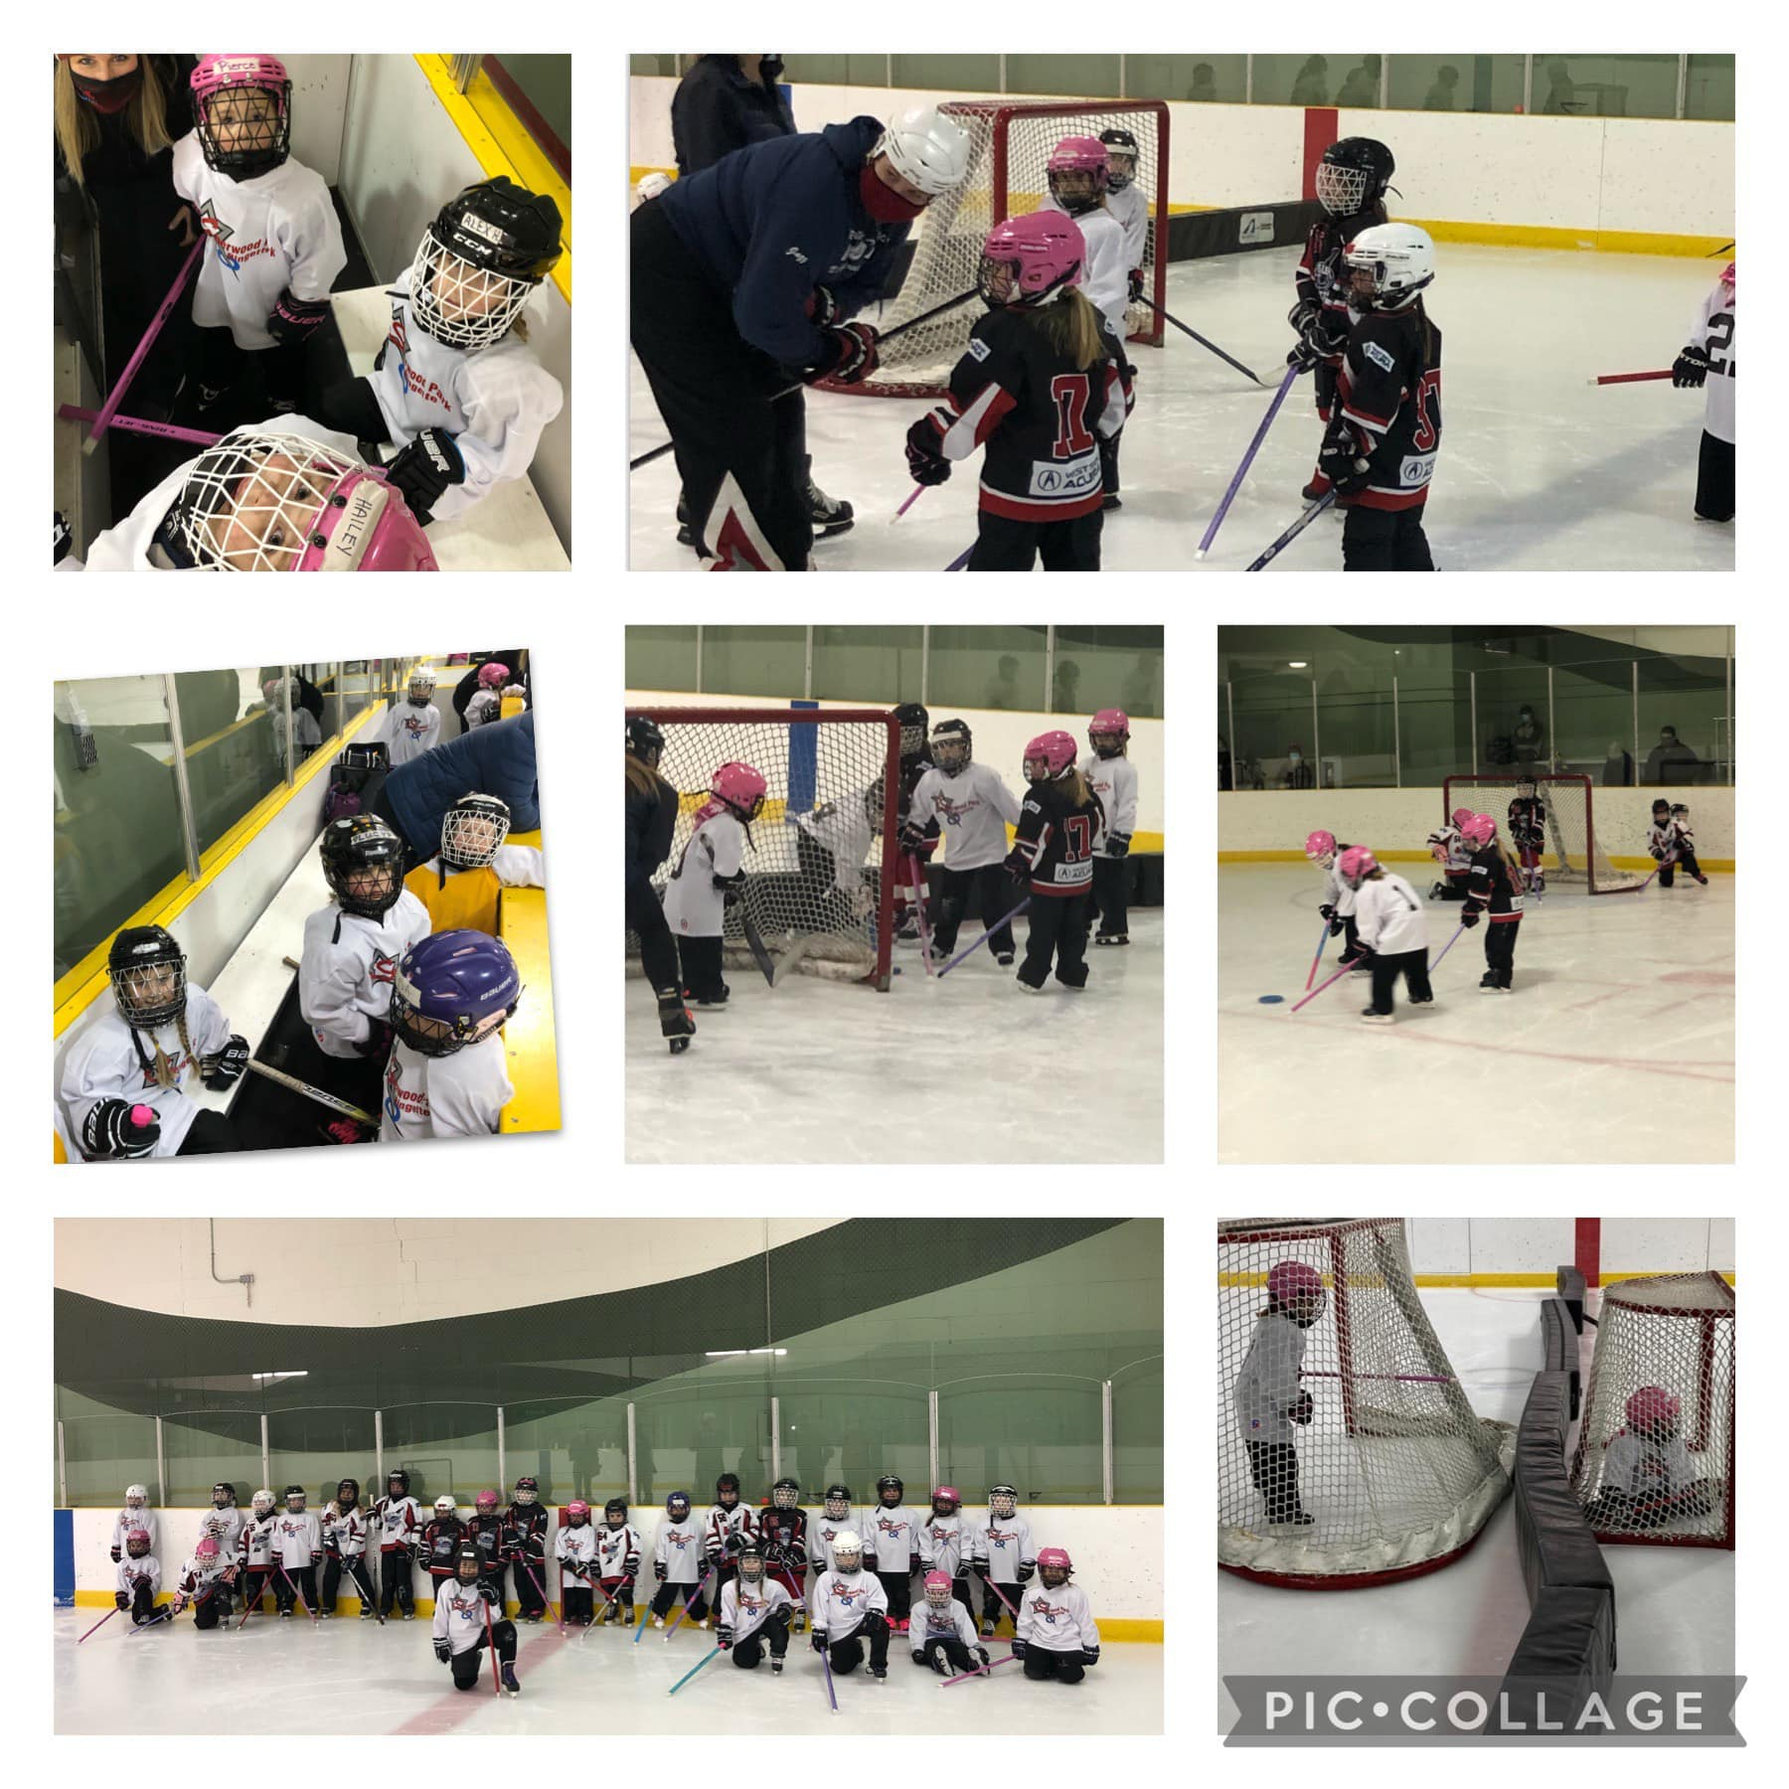
The Active Start Huskies hosted St.Albert last night and had a blast!! 💥 It’s incredible to see the difference in them in only a few short months. Some went from barely skating and a lot of tears to having so much fun. #spra #ringette

Slide 8
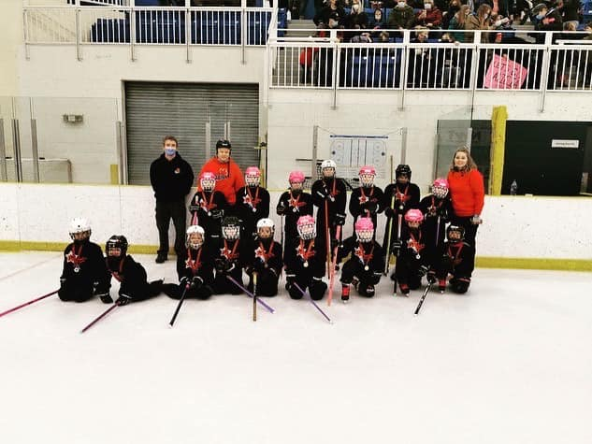
The AS2 Panthers had so much fun at the Spruce Grove Ringette Association Sweetheart Tournament this weekend!! The team played their hearts out!

Slide 9
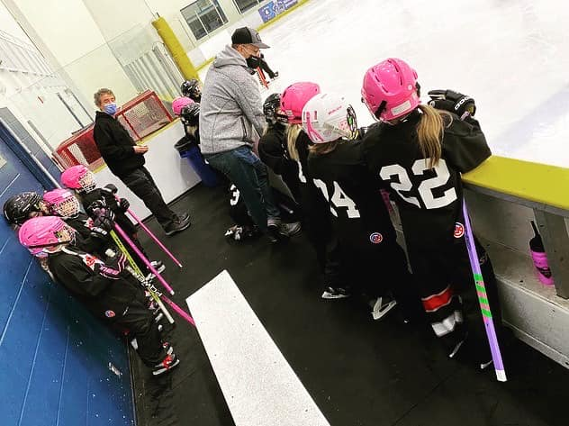
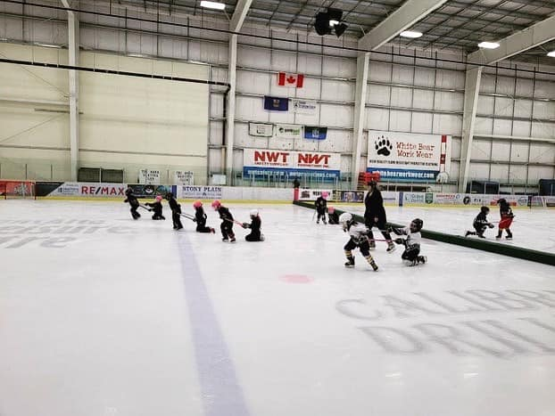
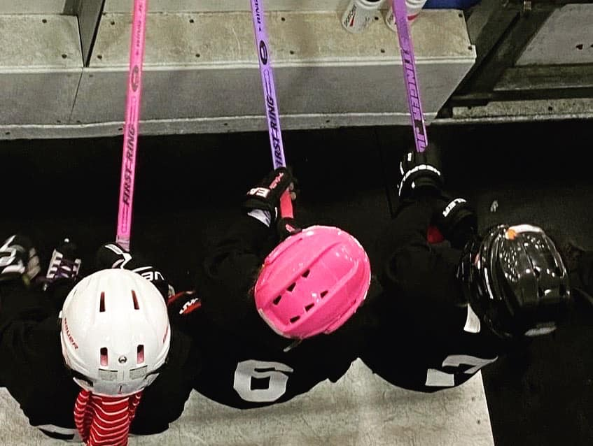
The AS2 Panthers

Slide 10
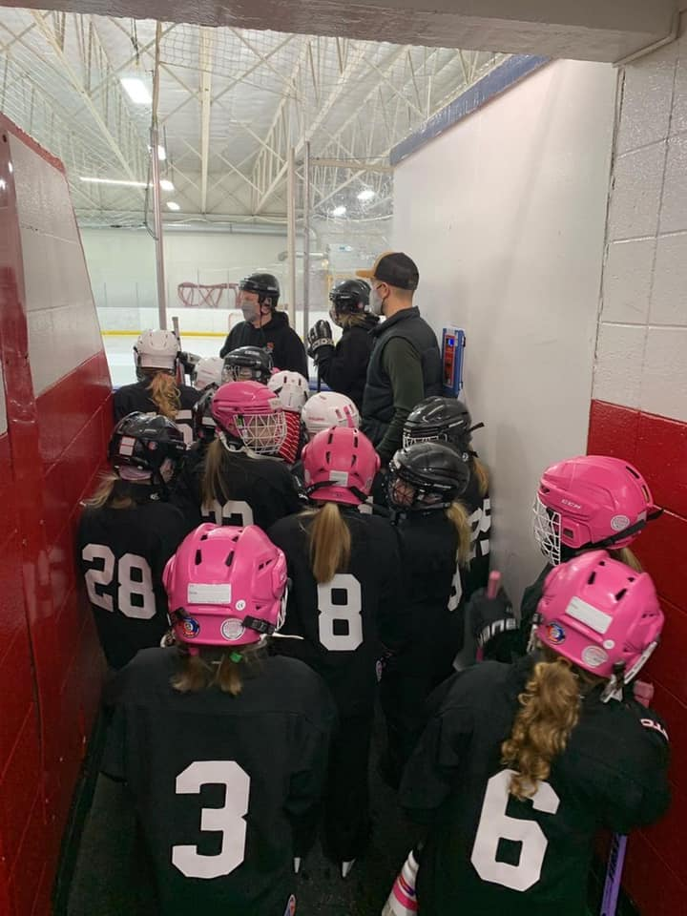
AS2 had a fun game against the AS Edmonton team!!! Girls worked so hard!! #spra #ringette

Slide 11
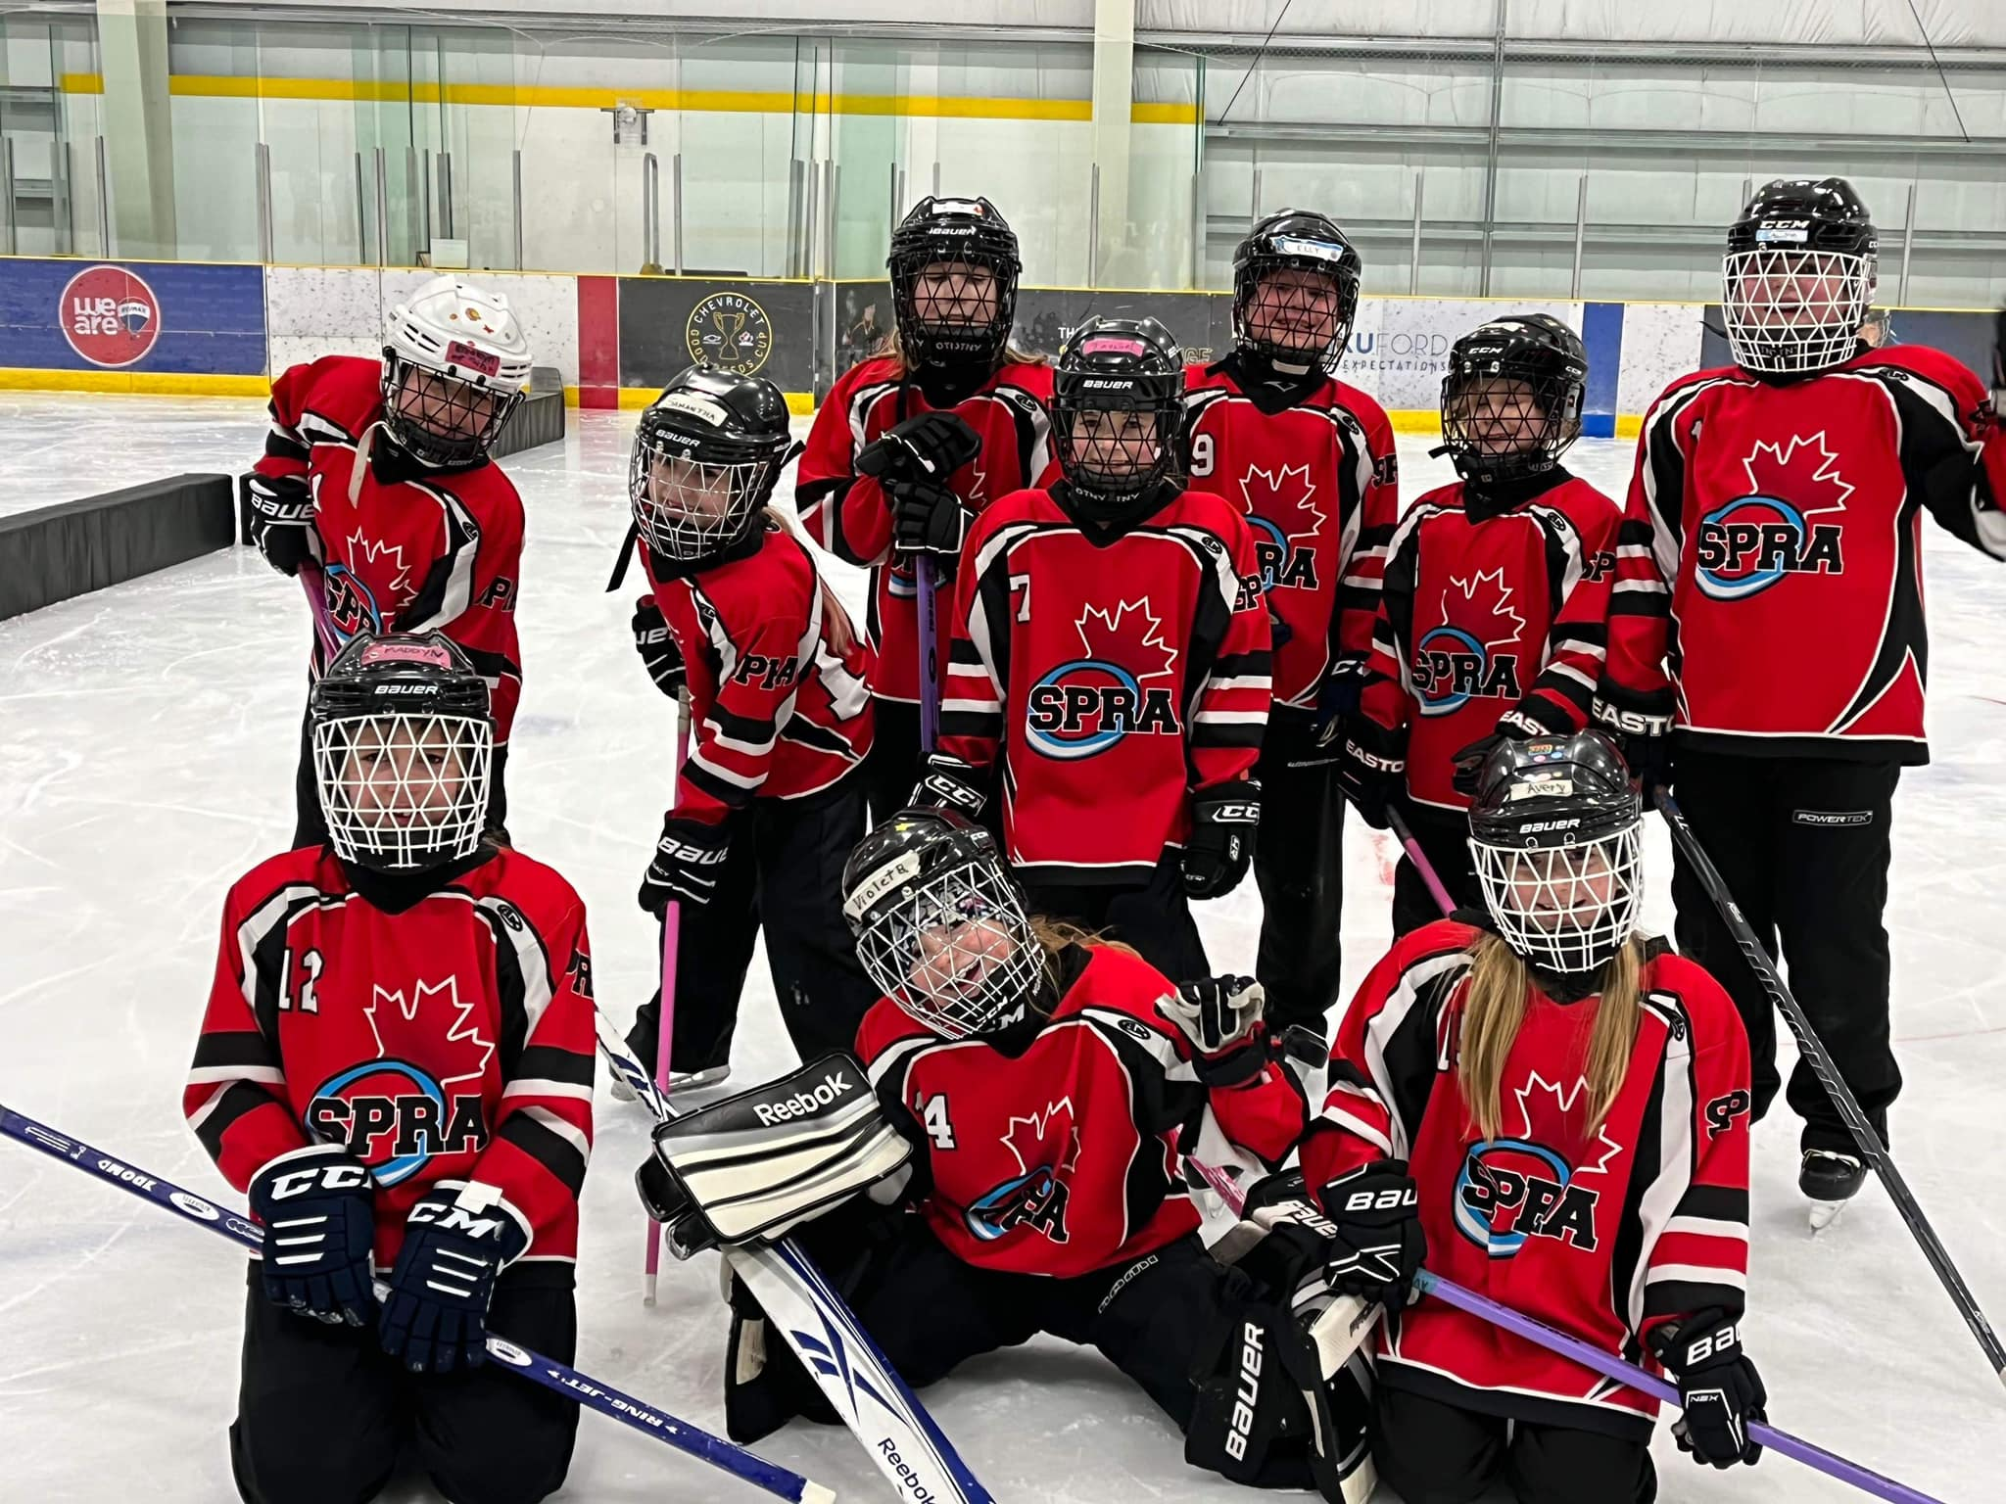
The U10 S2 Lightning are having a great time at the Leduc Ringette Wild Thing tourney!

Slide 12
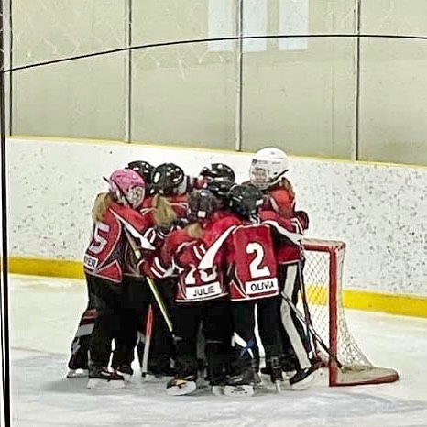
U10S3 Warriors in the Platinum Ring!!
#spra #ringettetournament

Slide 13
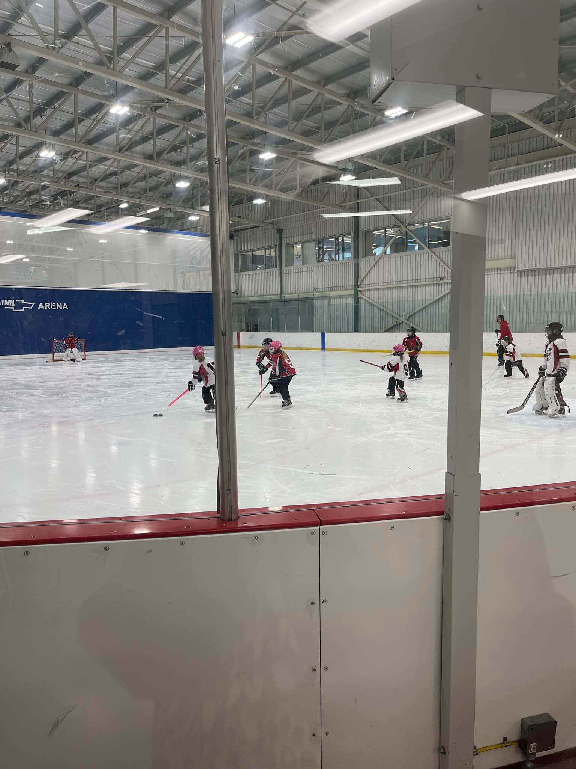
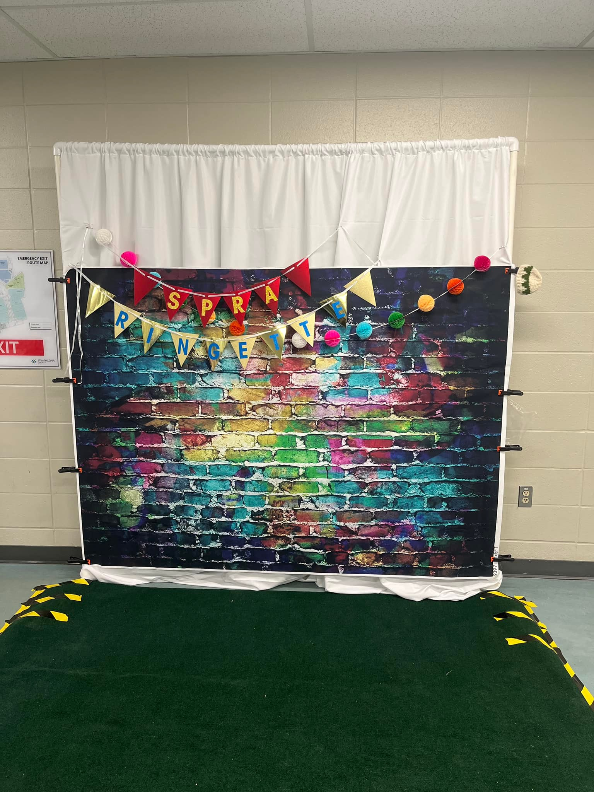
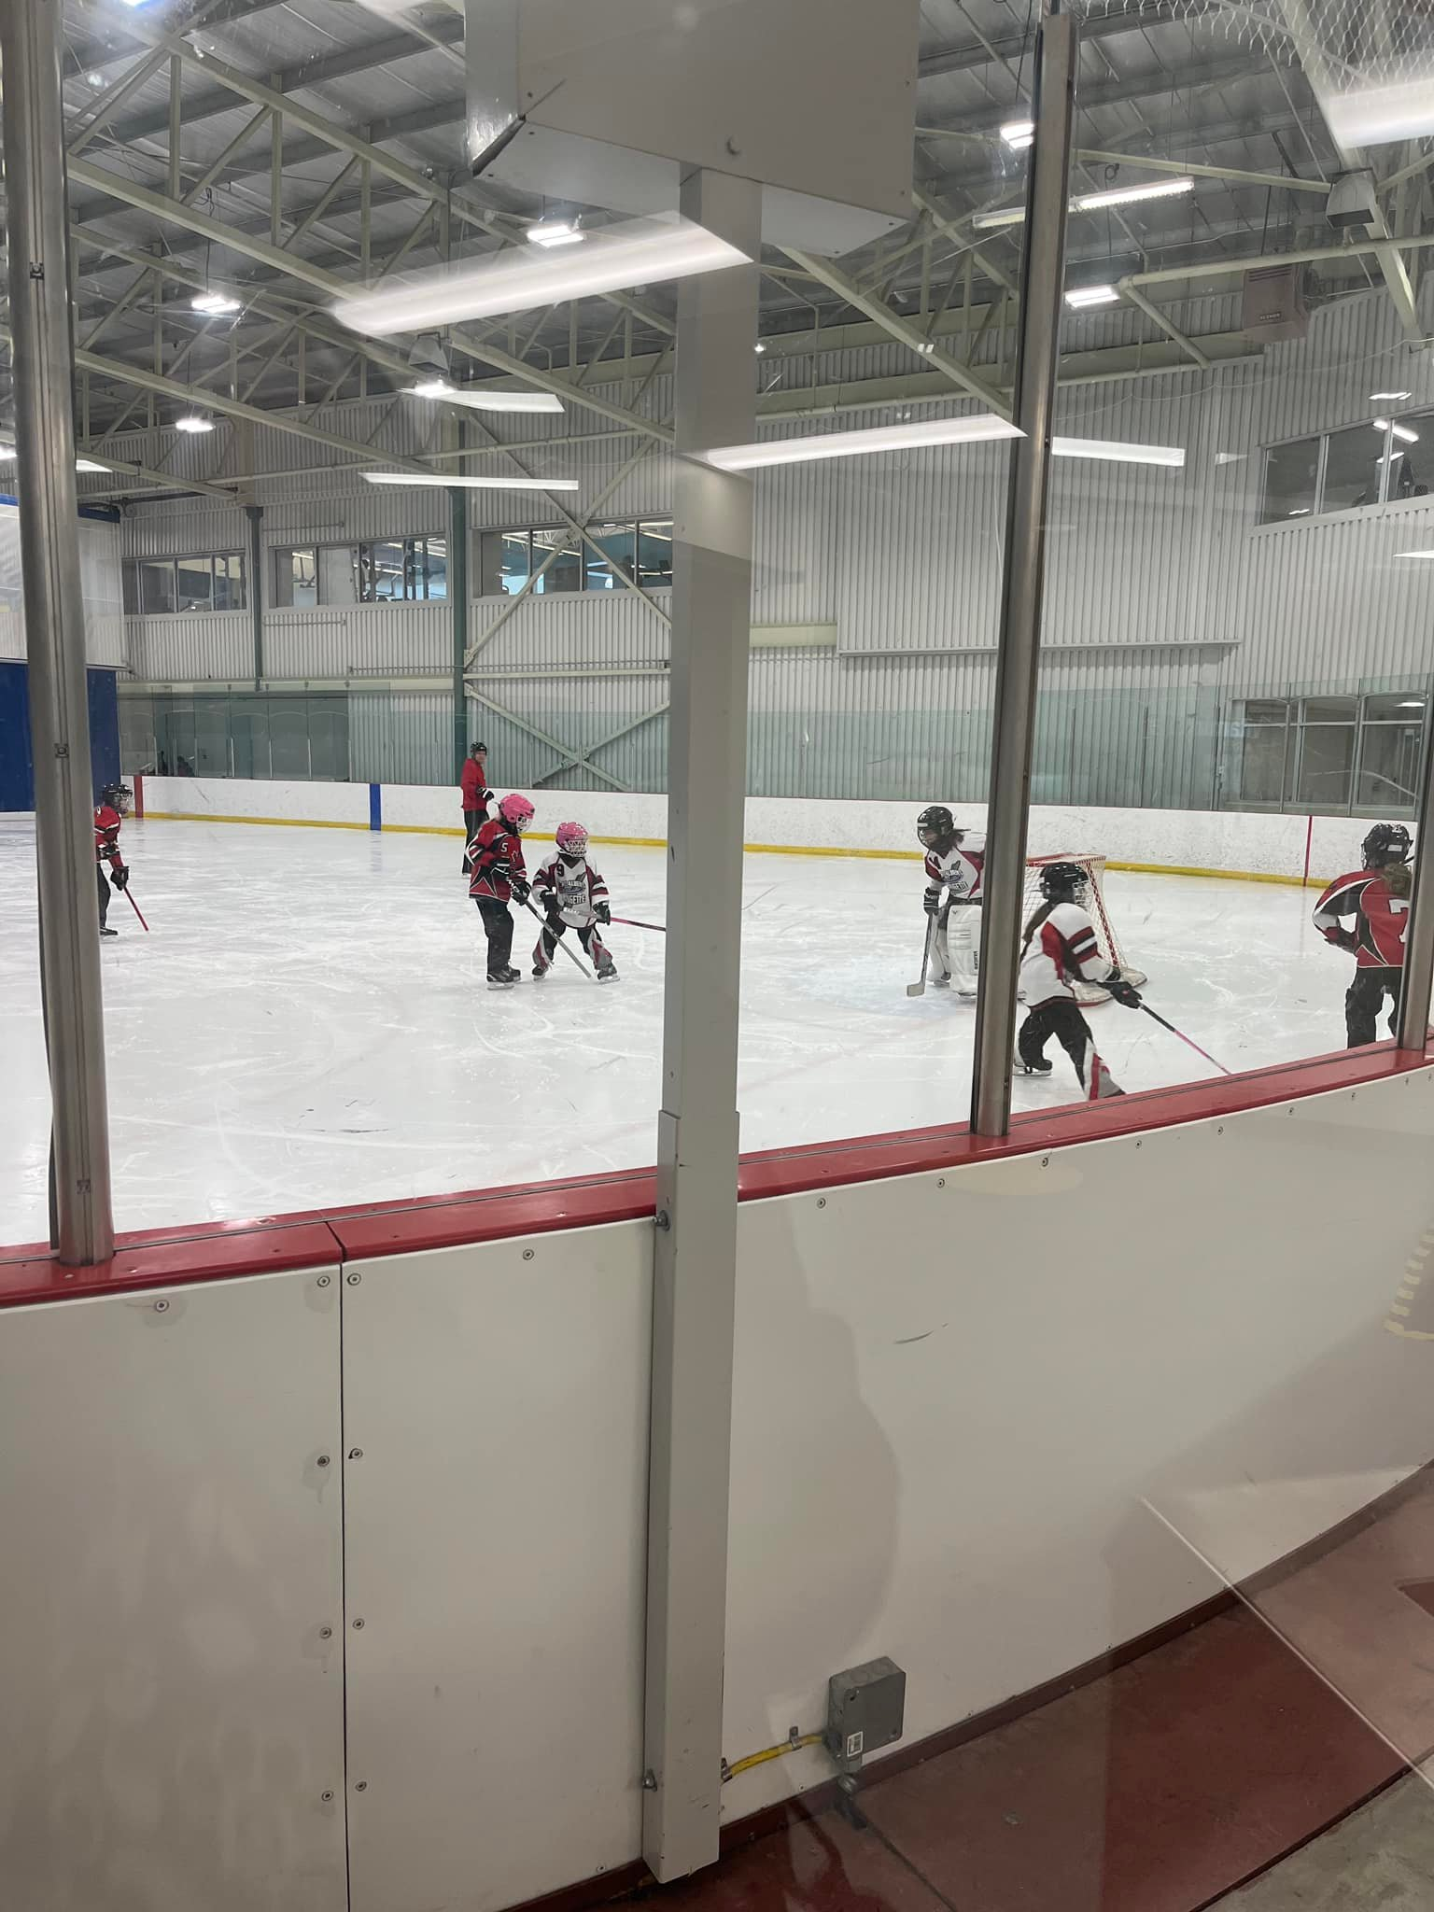
Our Active Start and U10 S1 Red Hawks and Shooting Stars, and S2 Lightning and Frogs, had fun in the mini platinum ring tournament!

Slide 14
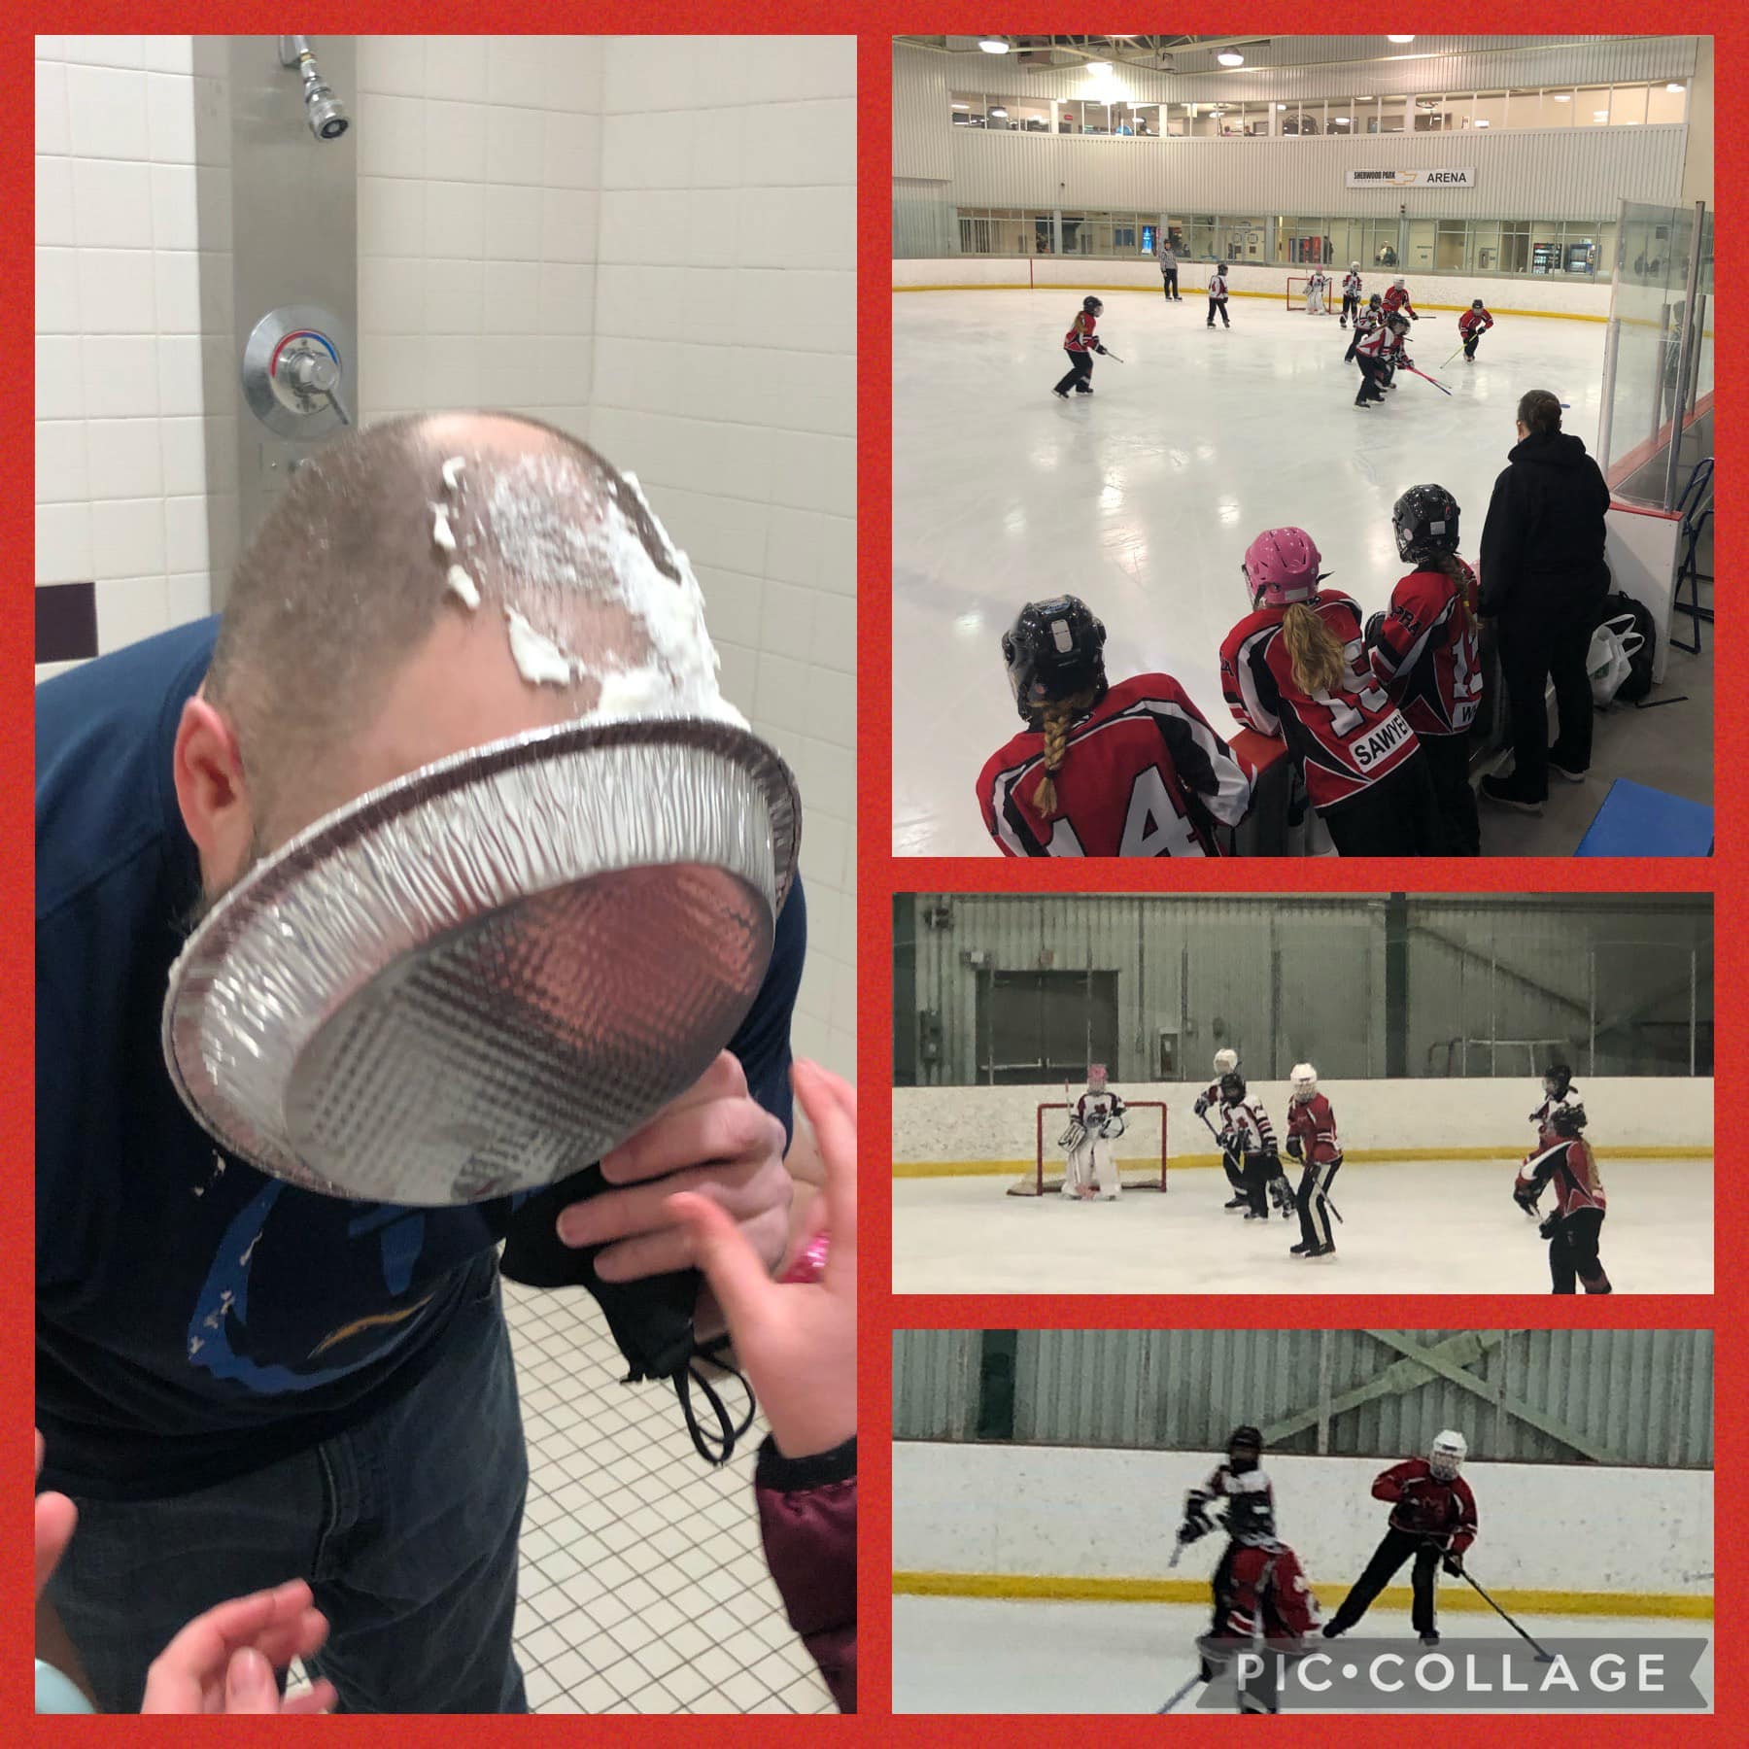
The U10-Step 3 Warriors and Devils faced off for their last regular season game. All the players dug deep to make it a really exciting game.
The Warriors came out on top - complete with a whipped cream pie for Coach Steve for the win!

Slide 15
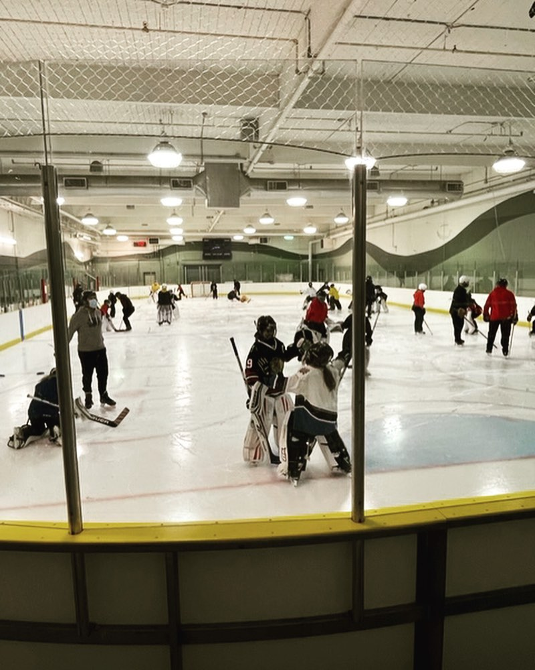
U10/U12 Goalie Clinic!!

Slide 16
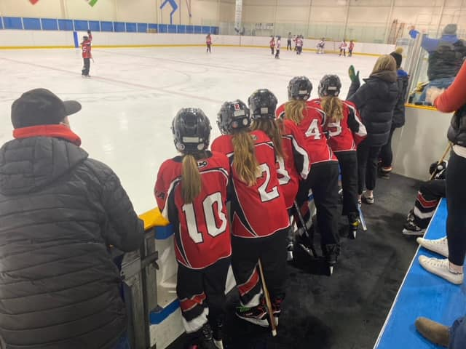
U12A Rage had an outstanding weekend full of grit and team success. These players battled hard in 3 games over the weekend against Lacombe, Red Deer and the SPRA Terminators! Way to go Rage!!

Slide 17
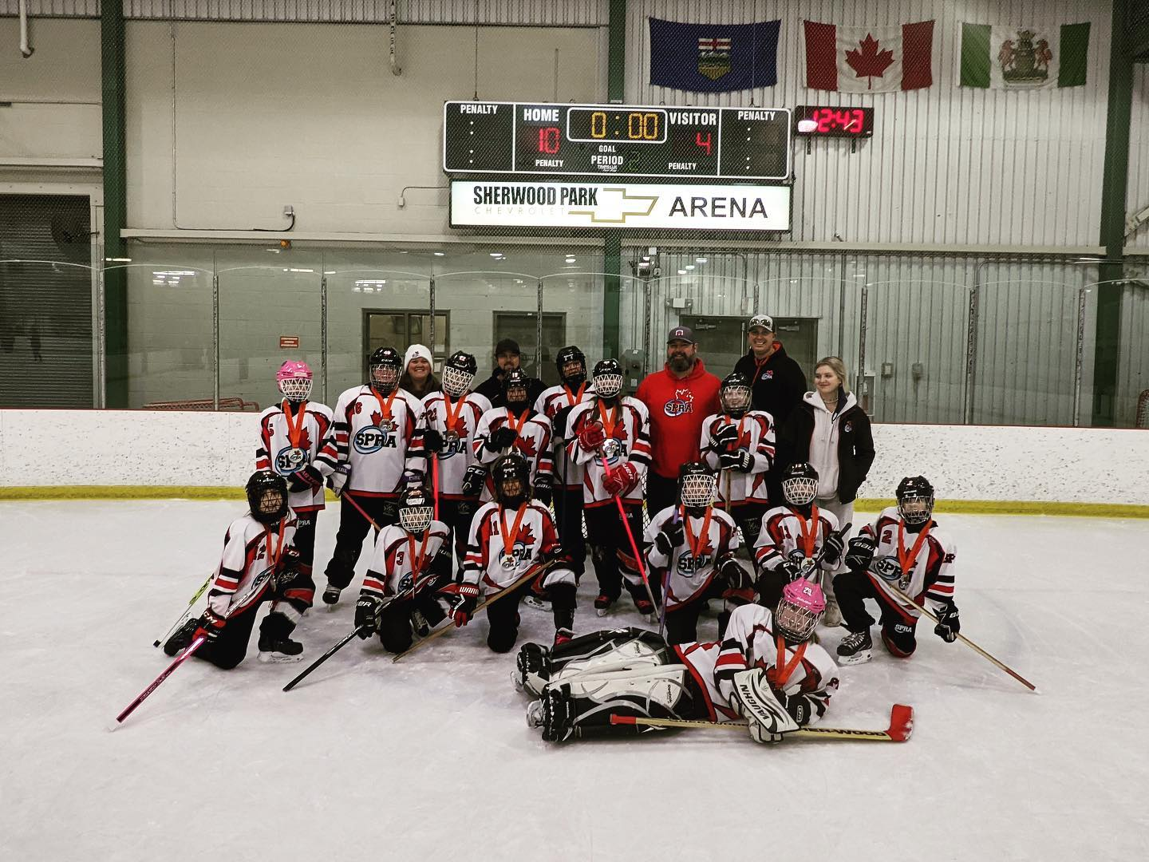
Congrats to the U12B Cobras on their SILVER MEDAL! #platinumring2021

Slide 18
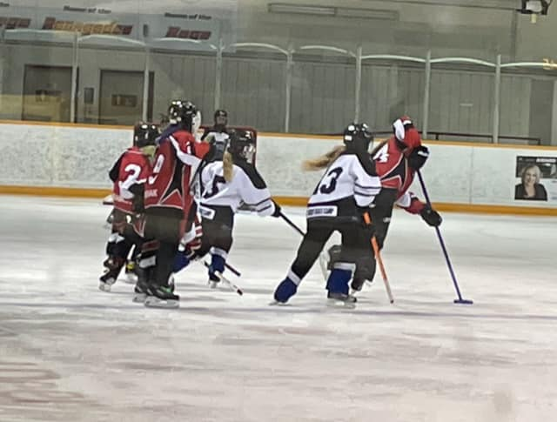
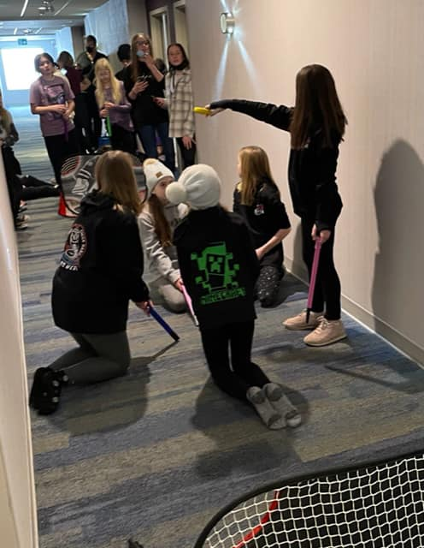
The U12B Cobras spent the weekend in Red Deer. An exhibition game on Saturday and their last league game on Sunday both ending in a tie!

Slide 19
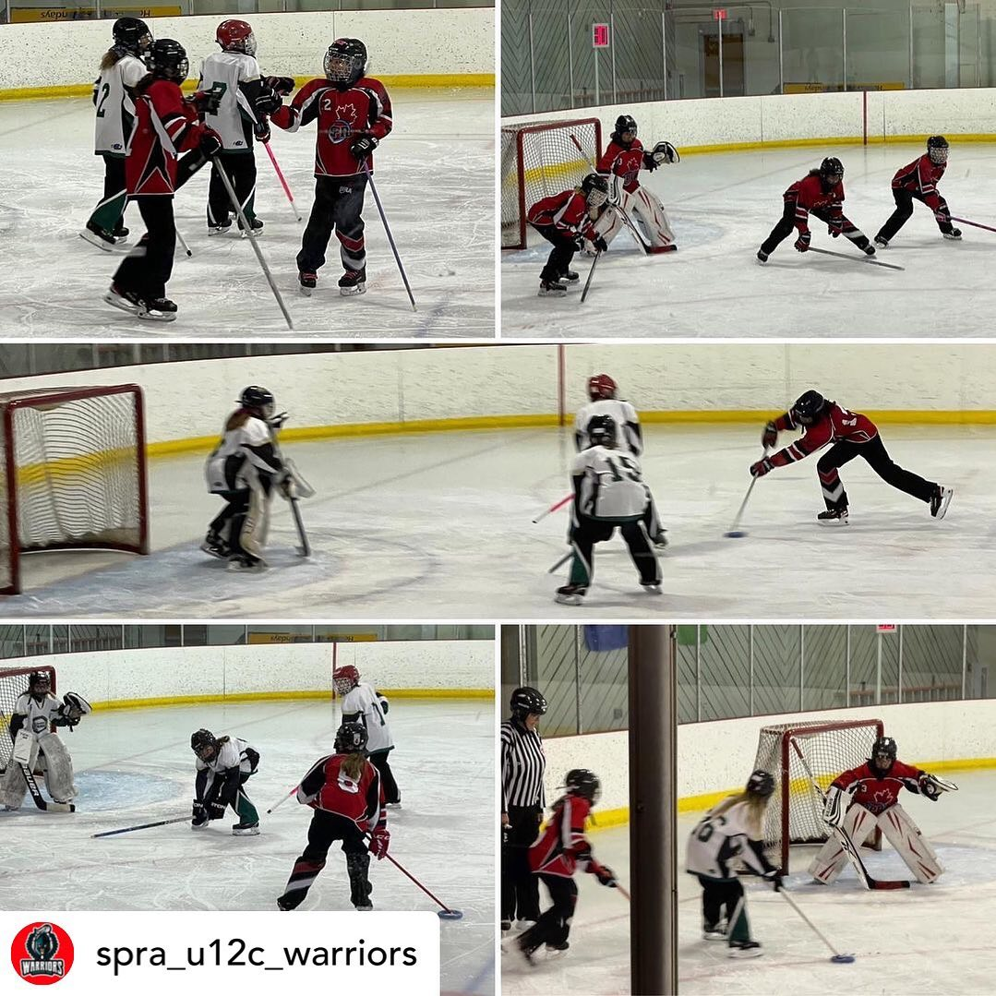
U12C Warriors in game play!!

Slide 20
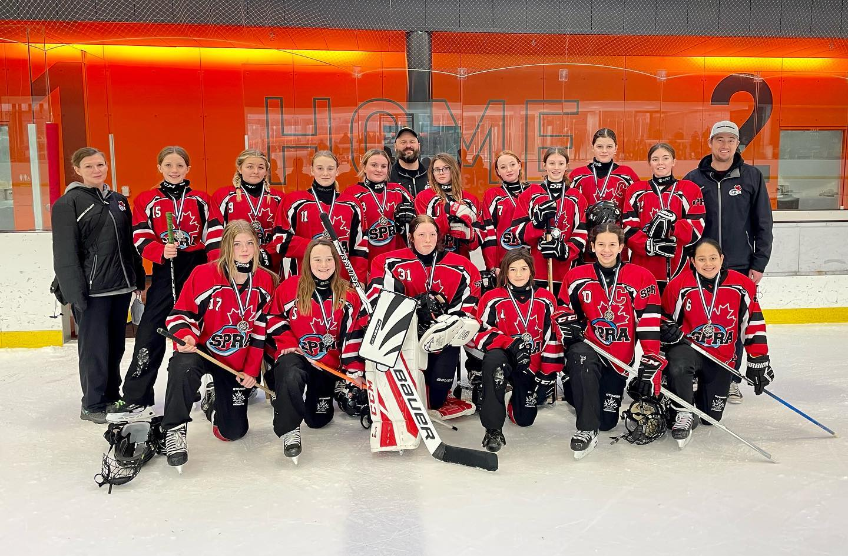
Congrats to the U14A Venom on their SILVER MEDAL in Ring in the Holidays!
They battled hard all weekend!

Slide 21
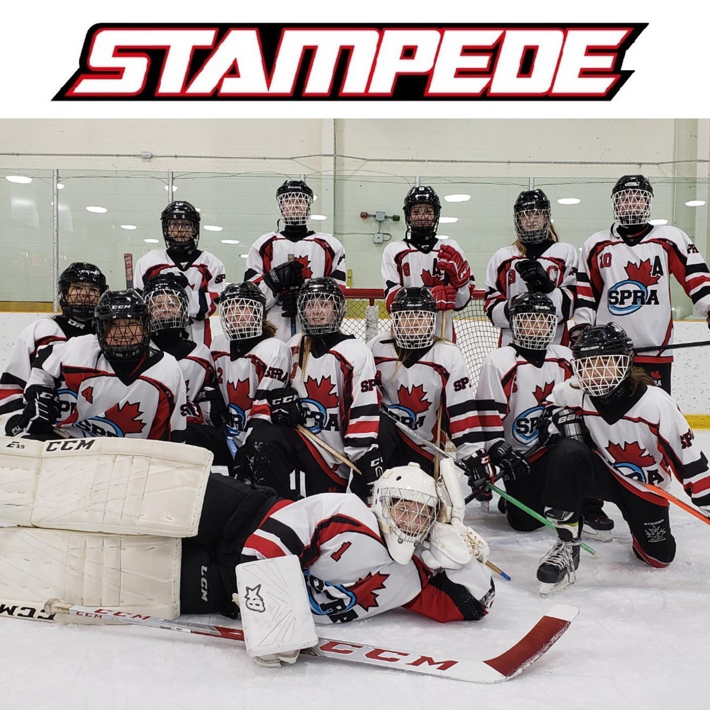
What a battle! Congratulations to our SPRA U14B bronze medal STAMPEDE team. #platinumring2021

Slide 22
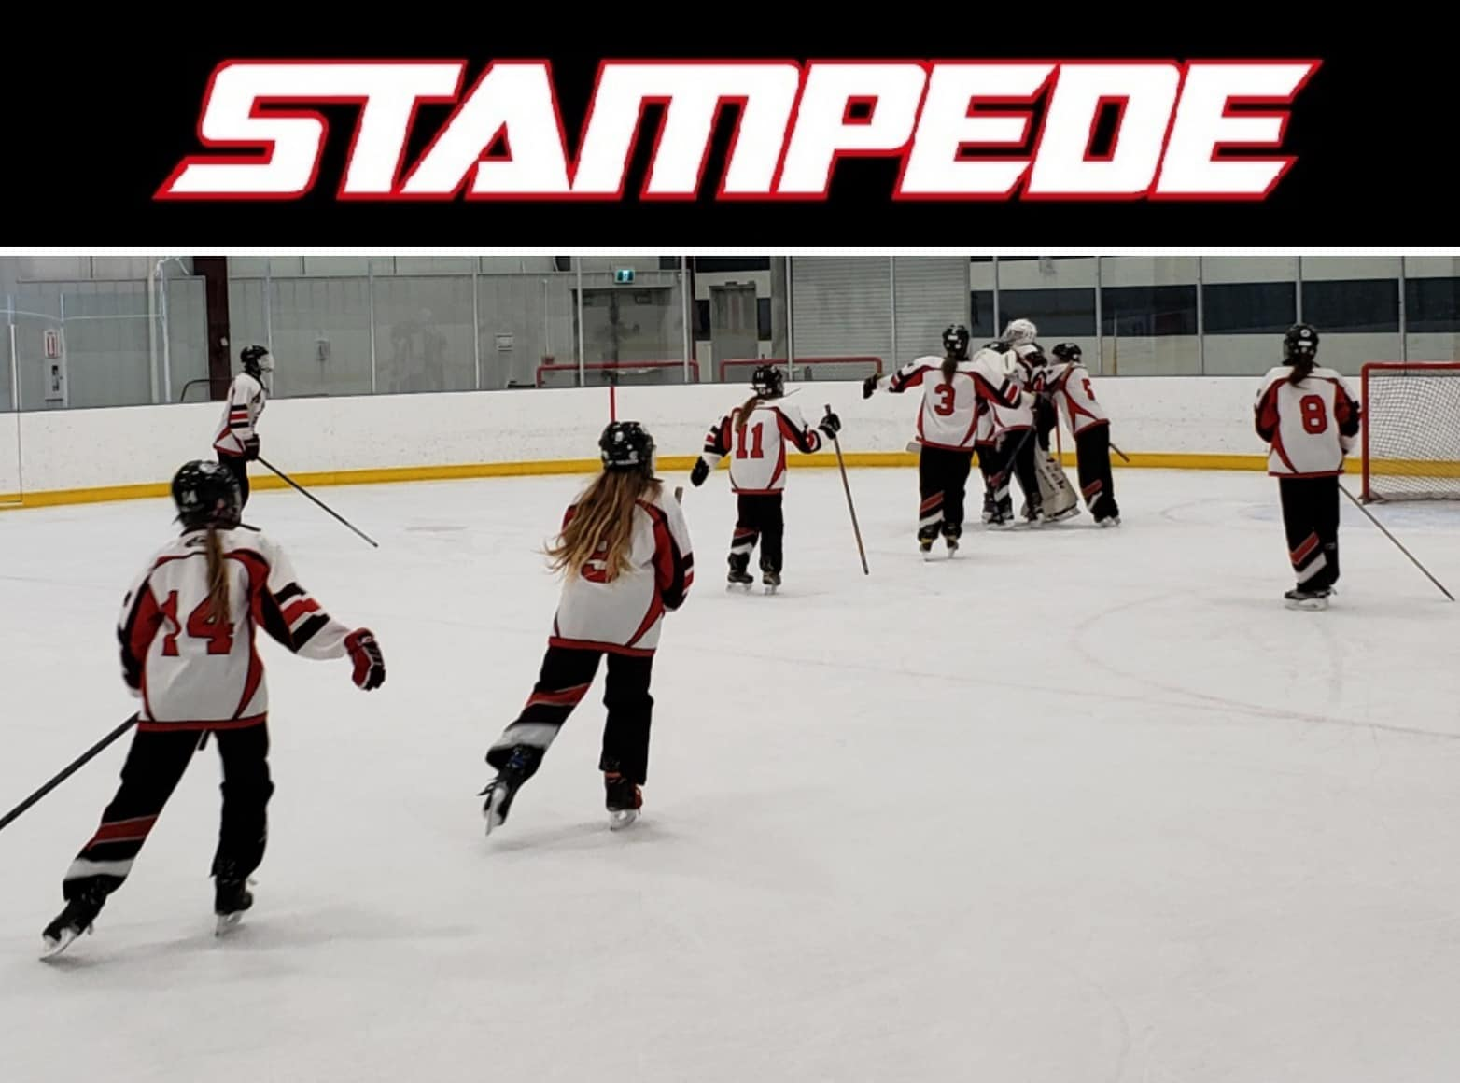
Victory for U14B Stampede! This team battled with determination. Down by a goal at the half, our Stampede came back with two great goals, tough defense, and amazing goaltending to secure the win in Beaumont!

Slide 23
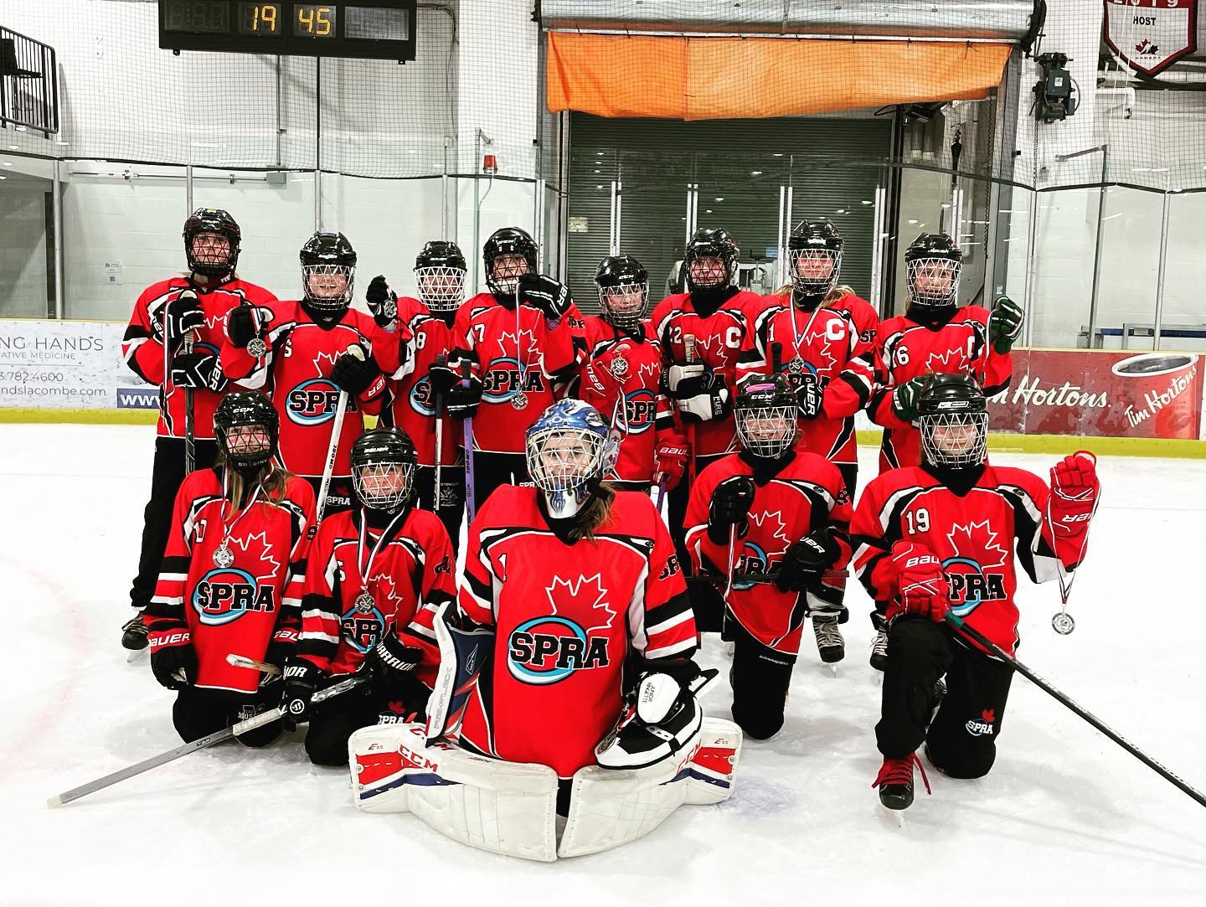
Congratulations to our mighty U14C Alpacas who are bringing home the SILVER MEDAL in the Lacombe Icebreaker tourney!! Thanks to Lacombe for your hospitality, competition and sportsmanship!!

Slide 24
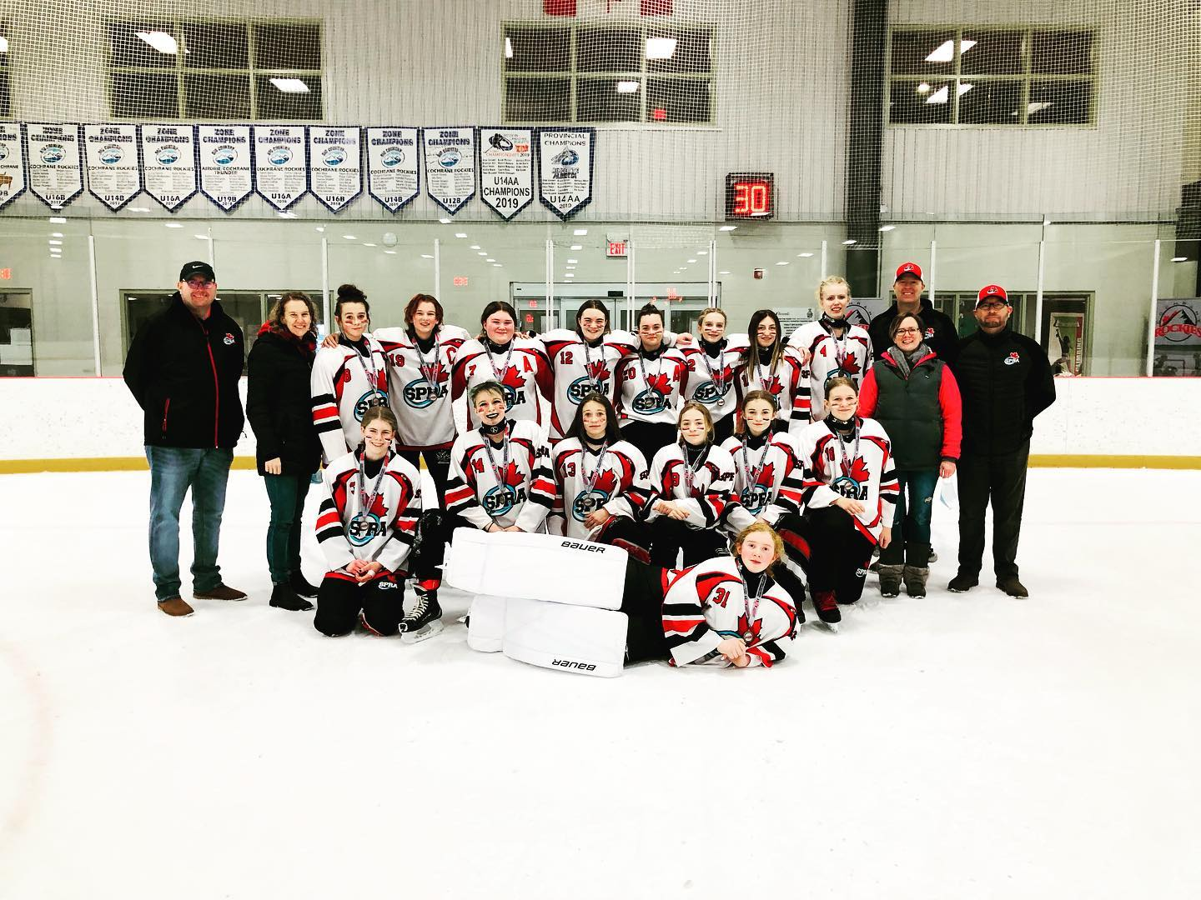
Silver medal for the U16B ACE! @scra_ringette ahead by only one goal! Thanks for hosting Cochrane!

Slide 25
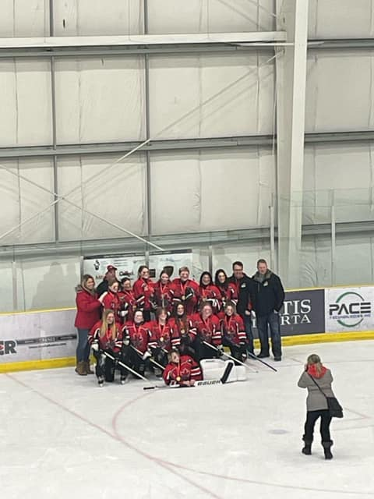
The U16B Riot took home GOLD after a 5-4 OT win in the Spruce Grove Ringette Association Sweetheart Tournament! Congratulations Riot!!

Slide 26
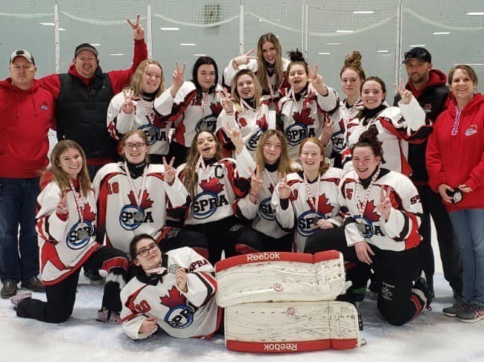
Congrats to the U19B Fury on their SILVER MEDAL at the Laurie Morton Ruppe Memorial Tournament!

Slide 27
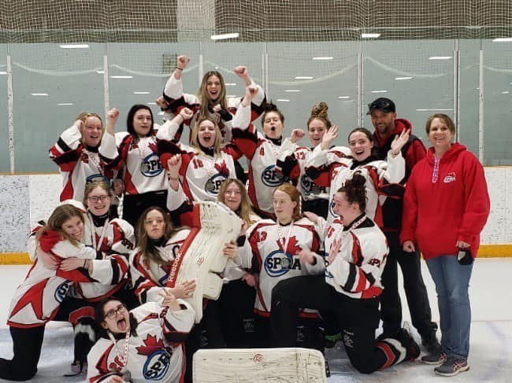
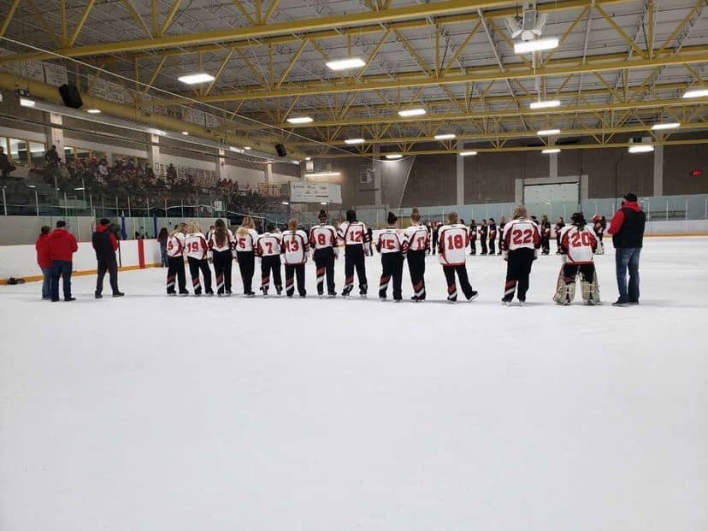
U19B Fury

Slide 28
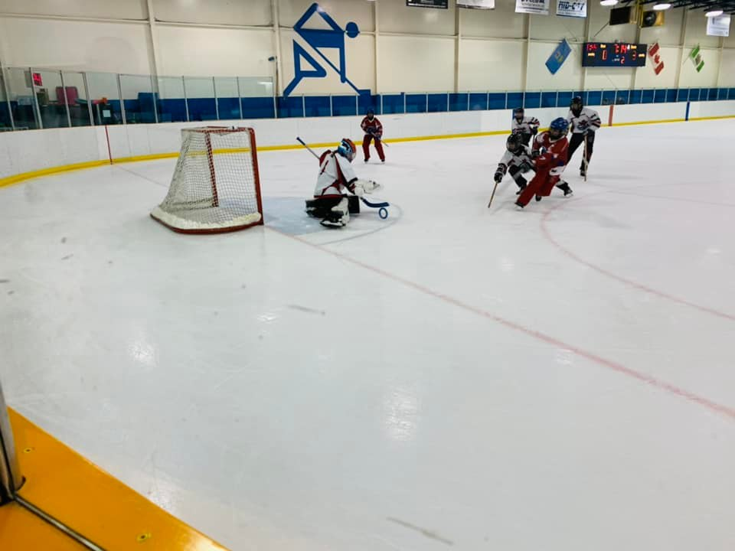
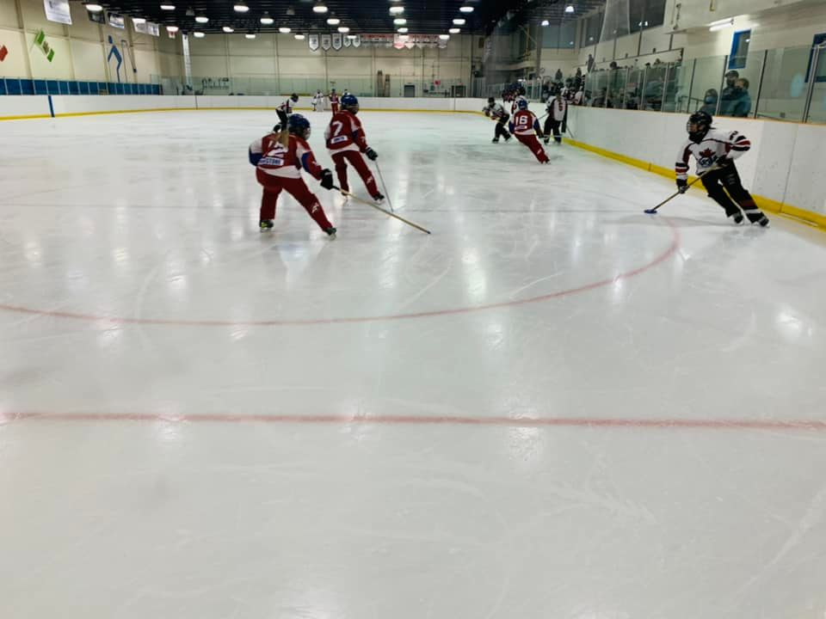
End to end action in the U19AA Power vs the Calgary U19AA Raid game!

Slide 29
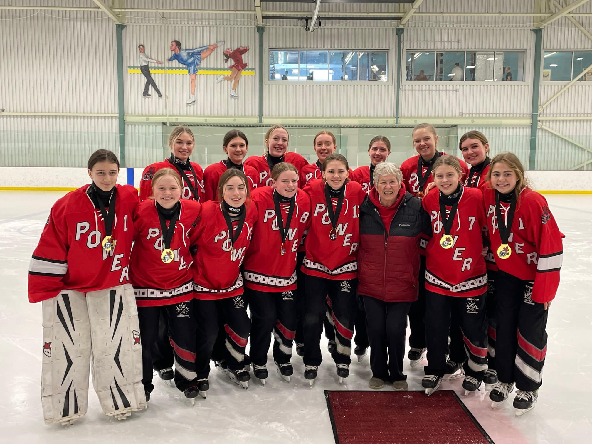
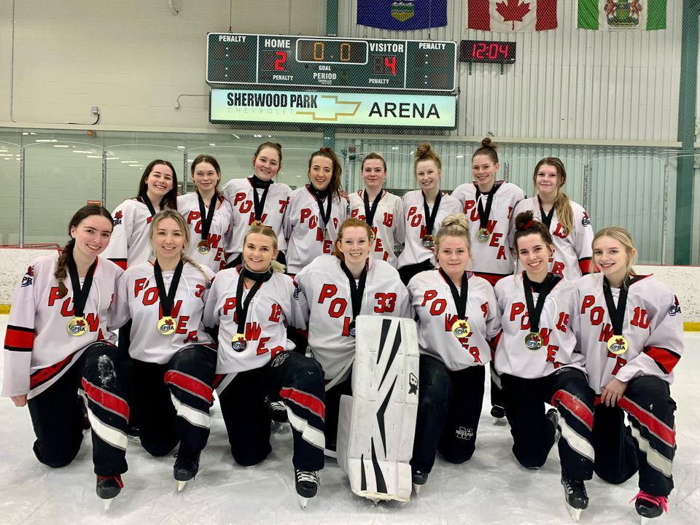
Phyllis Sadoway Tournament 2022

Slide 30
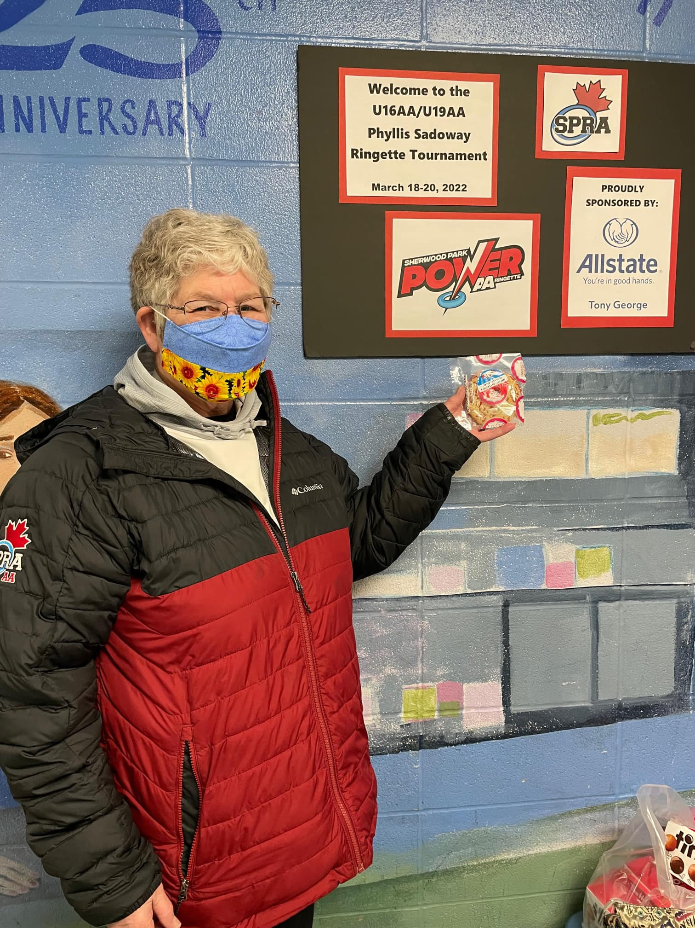
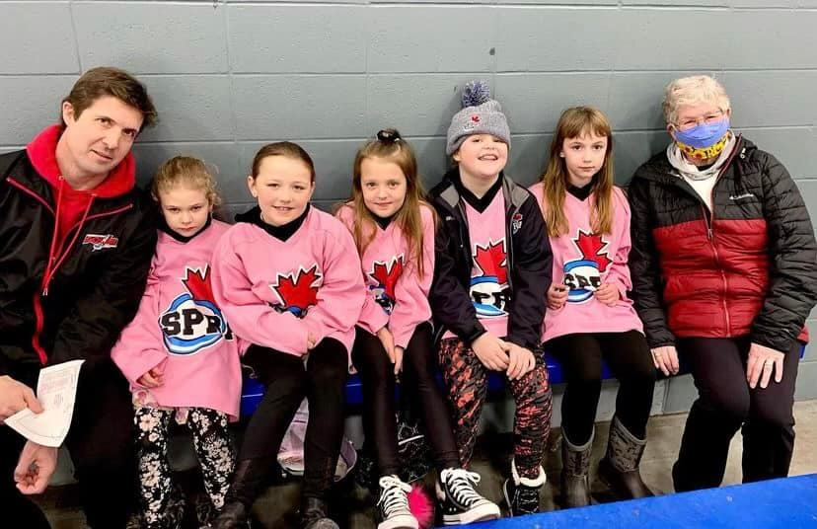
Phyllis Sadoway Tournament 2022
Thank you Phyllis!! ❤ Phyllis was at the rink supporting all of the teams that played! She did a trivia game with the teams, plus a speech and the medal presentations.
Thanks to Phyllis for all you have done for ringette in Sherwood Park and abroad! Congratulations to both Power teams!

Slide 33
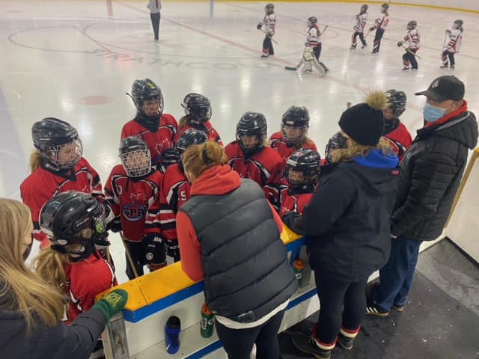
A few of our amazing coaching teams…..U12A Rage Coaches in action

Slide 34
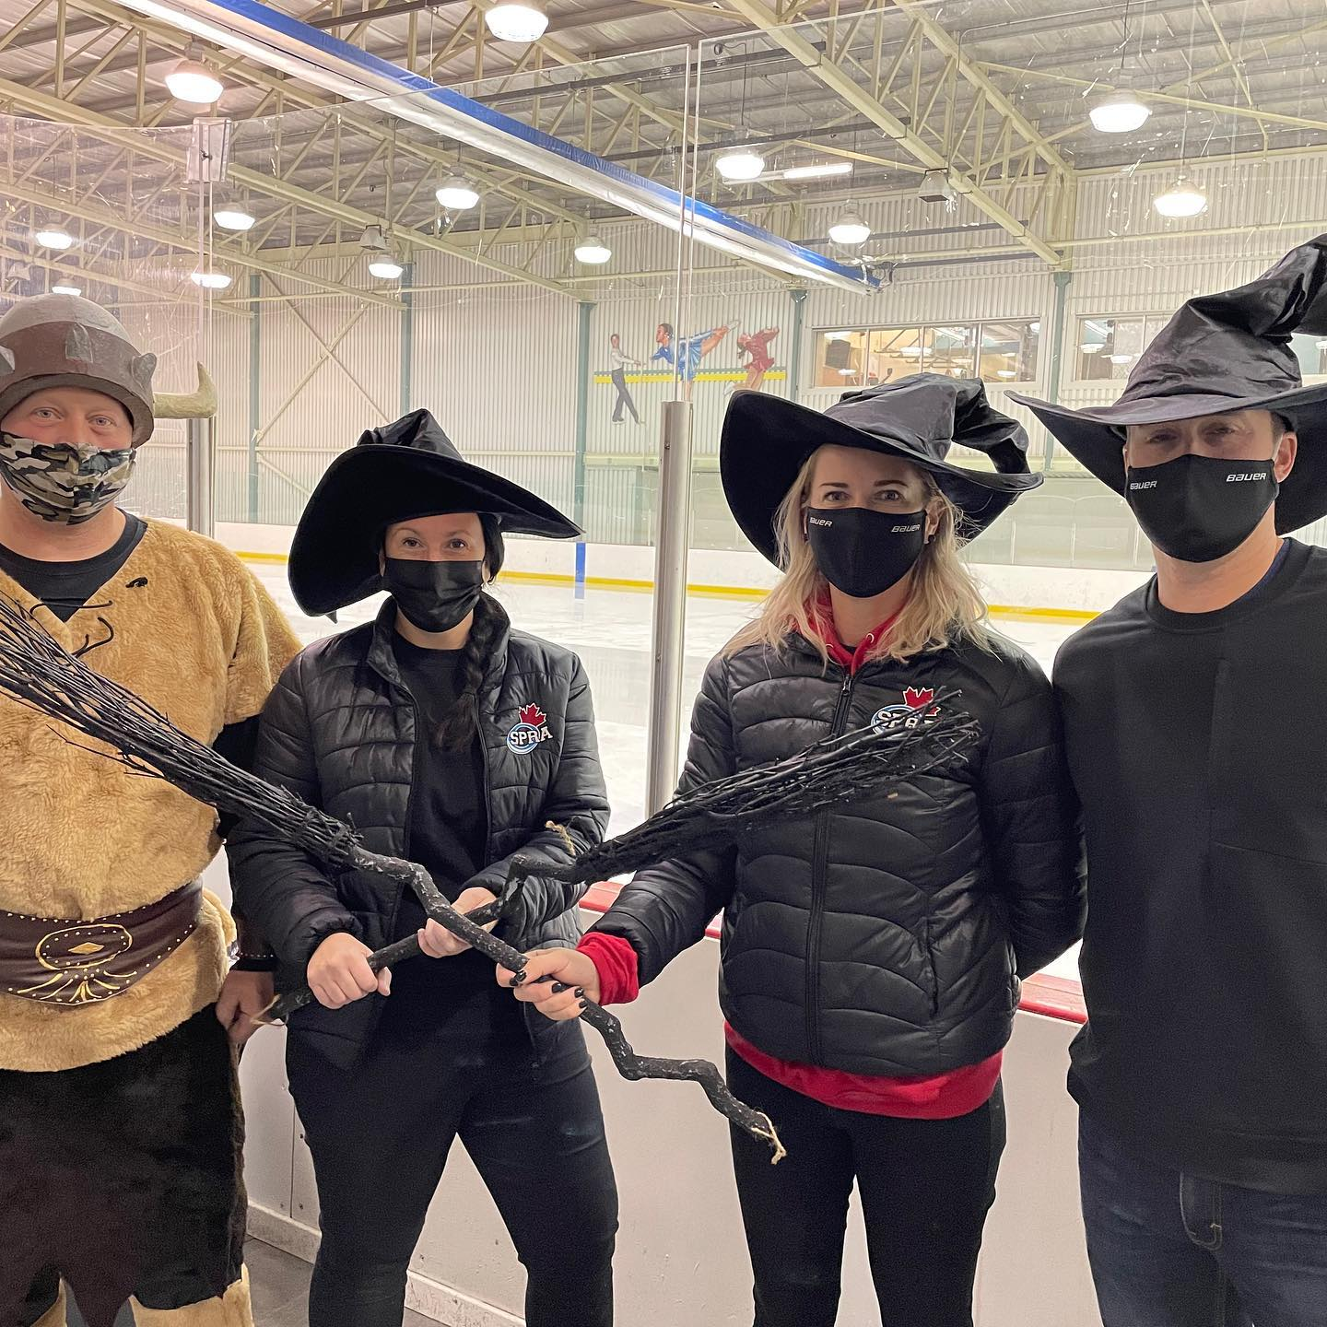
U12A
Terminator coaches in the spirit.

Slide 35
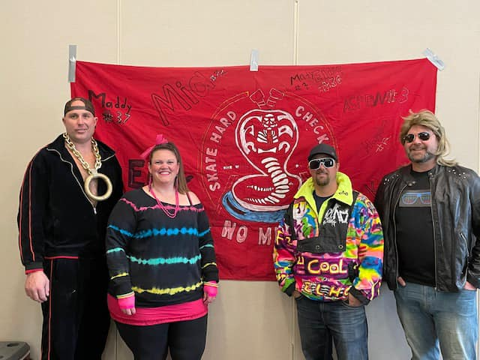
U12B Venom
Coaches, rockin’ the 80s vibe

Slide 36
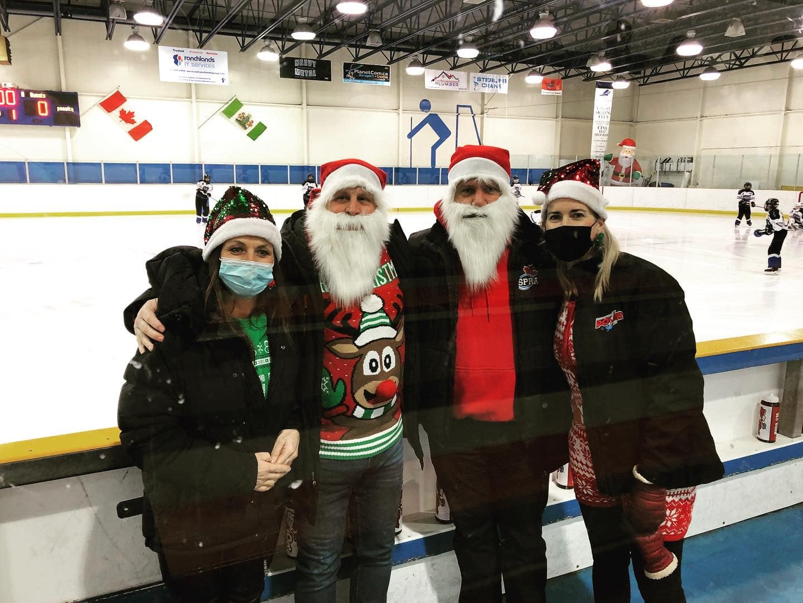
U14AA Coaches in the xmas spirit!

Slide 37
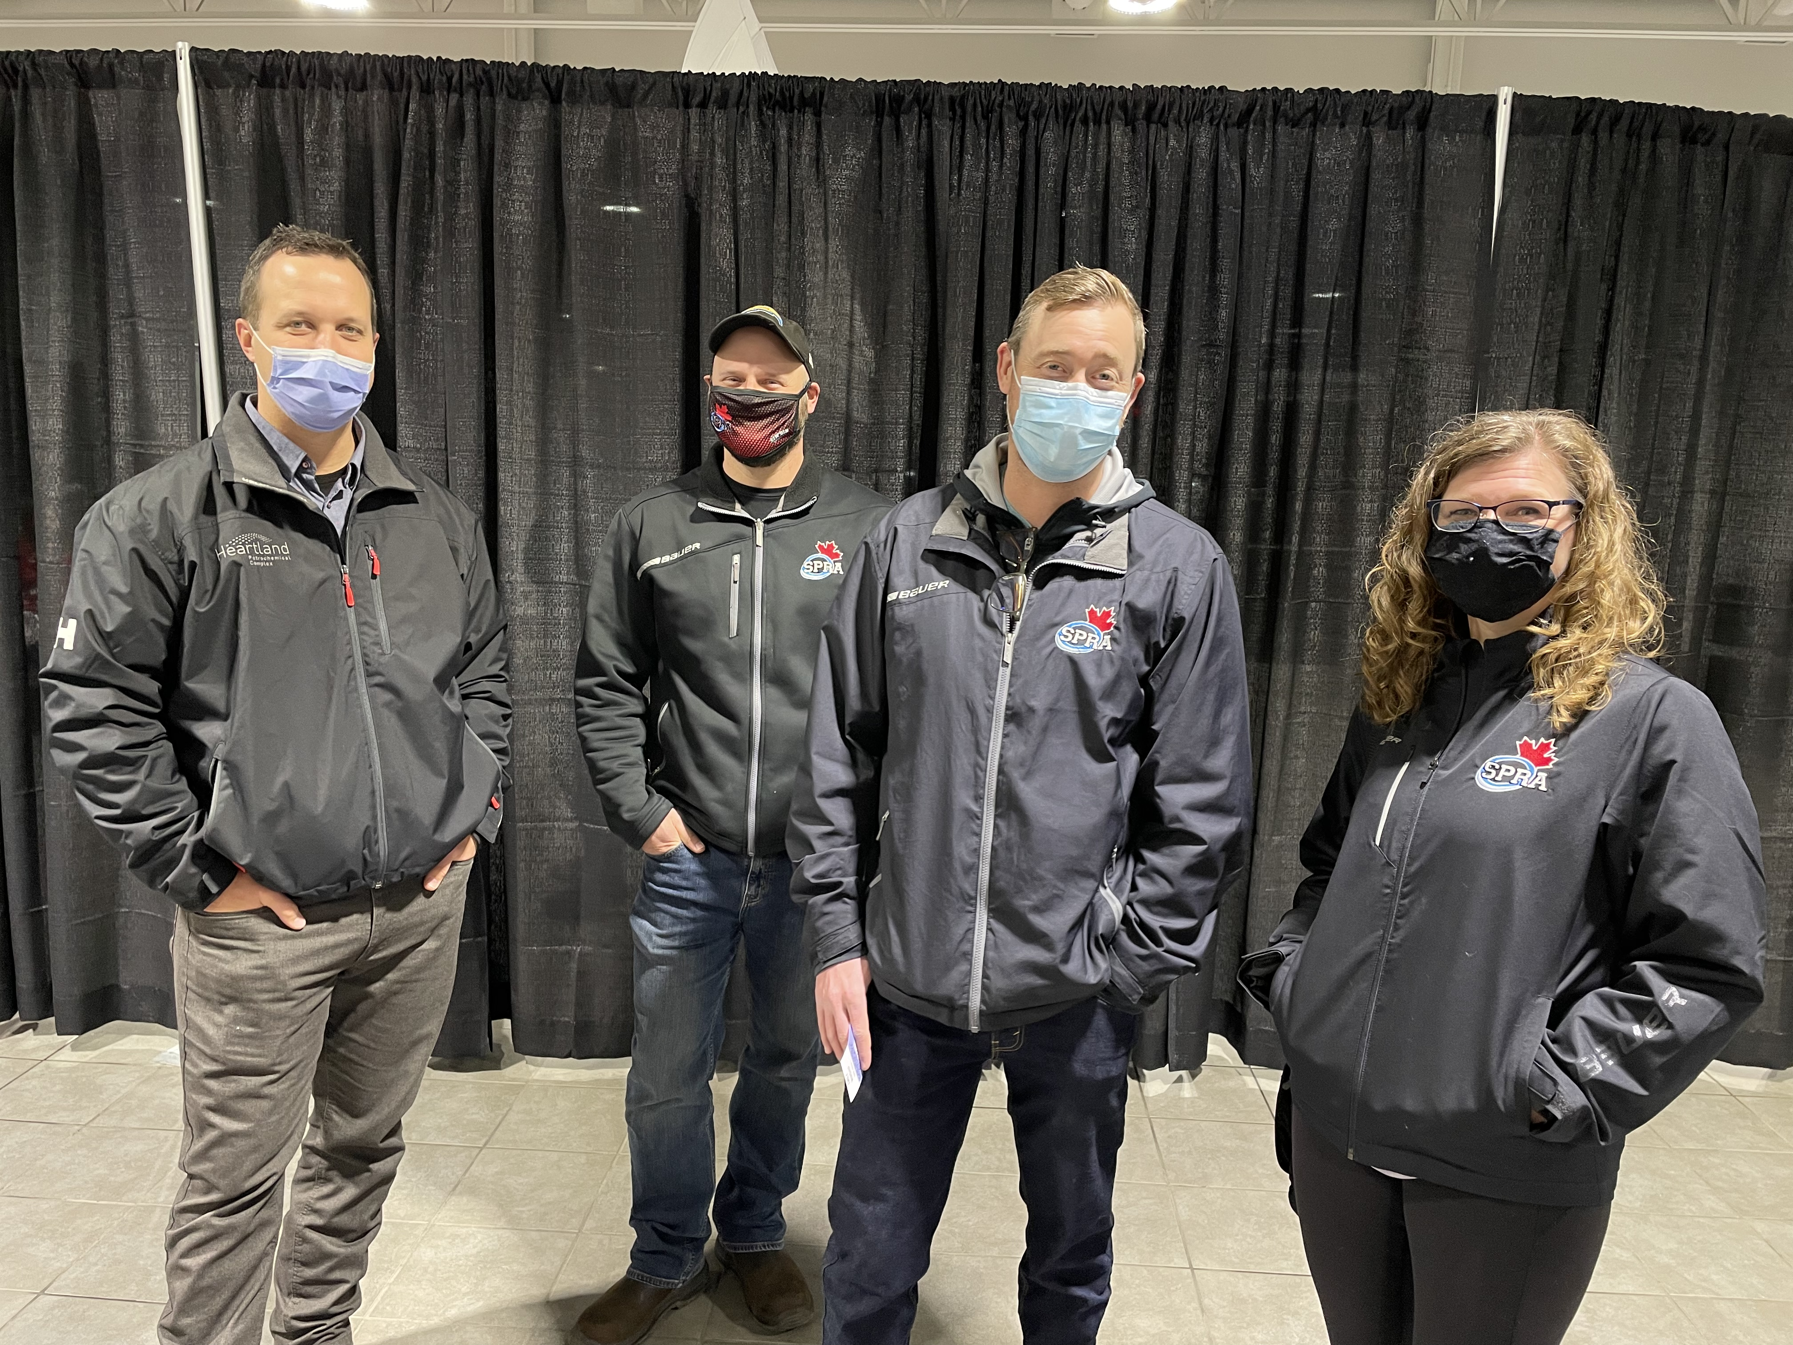
U14A Venom Coaches #inaband
#lookingcool

Slide 38
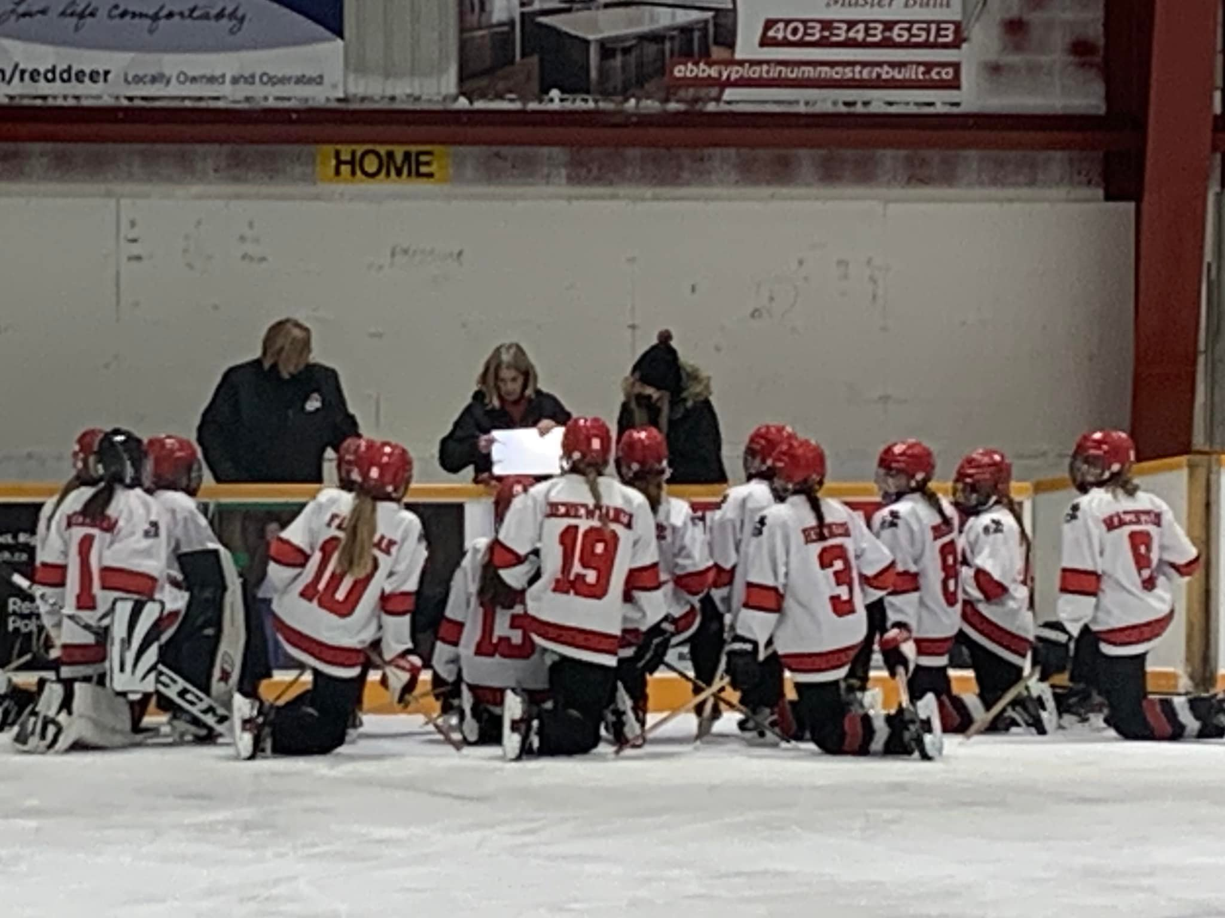
U16AA Coaches hard at work

Slide 39
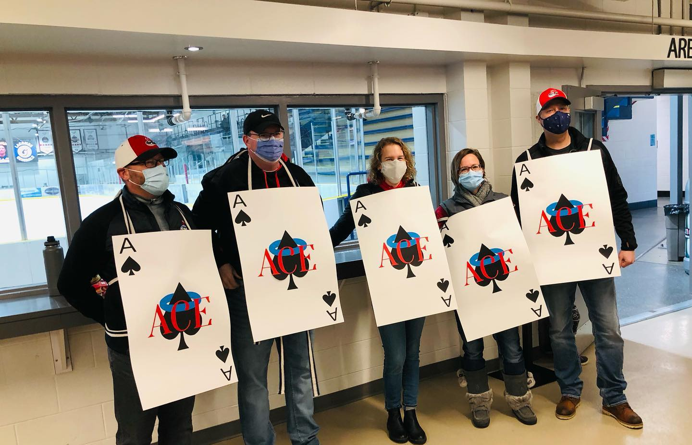
U16 ACE Coaches looking sharp!

Slide 40
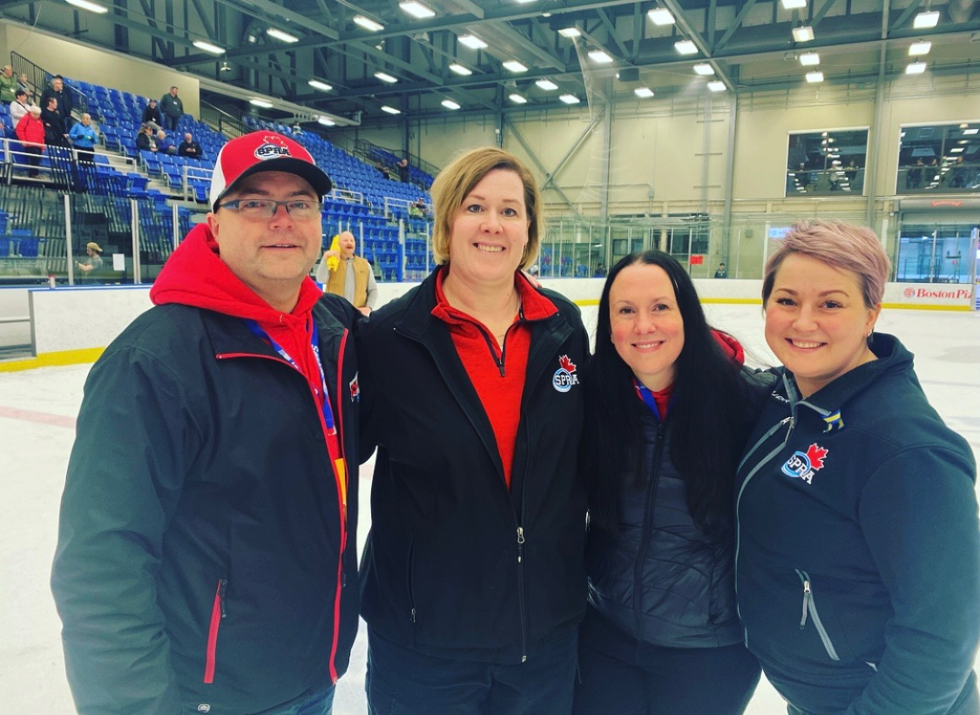
U16A Andrenaline
Coaches

Slide 43
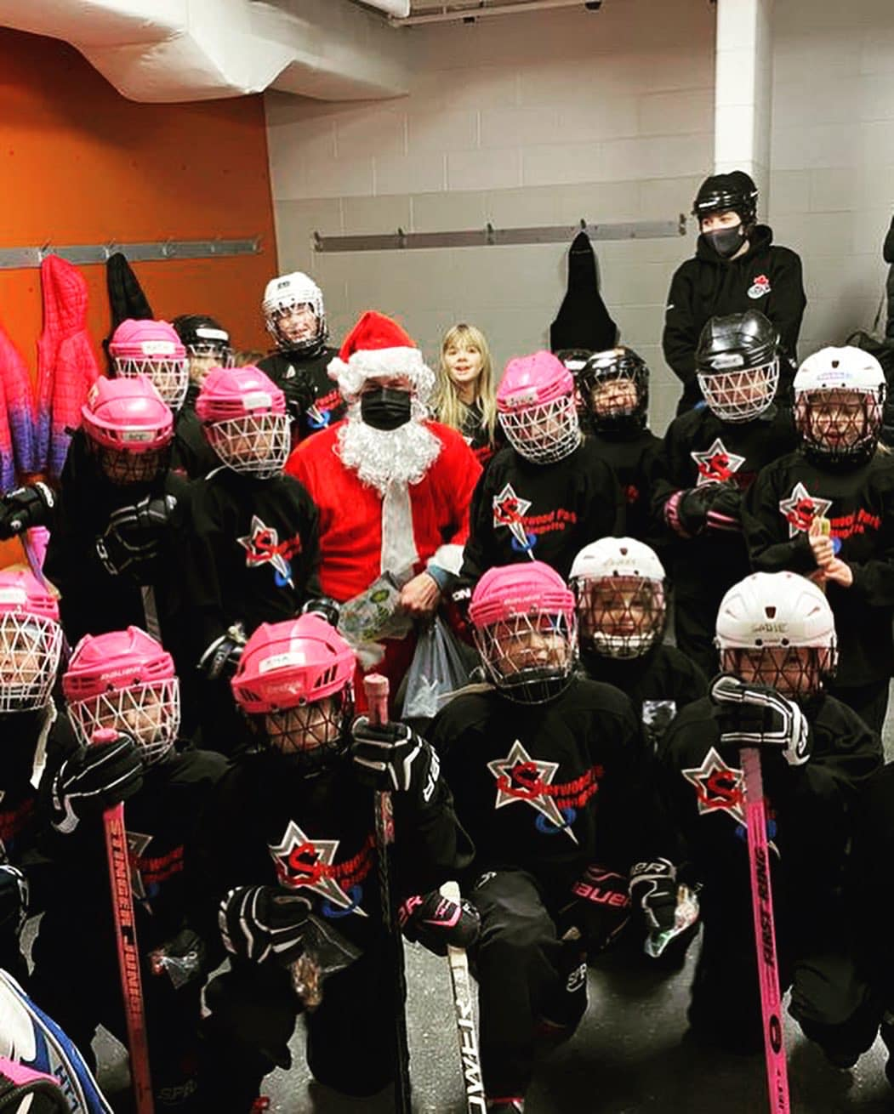
The AS2 Panthers had a visit from Santa!!

Slide 44
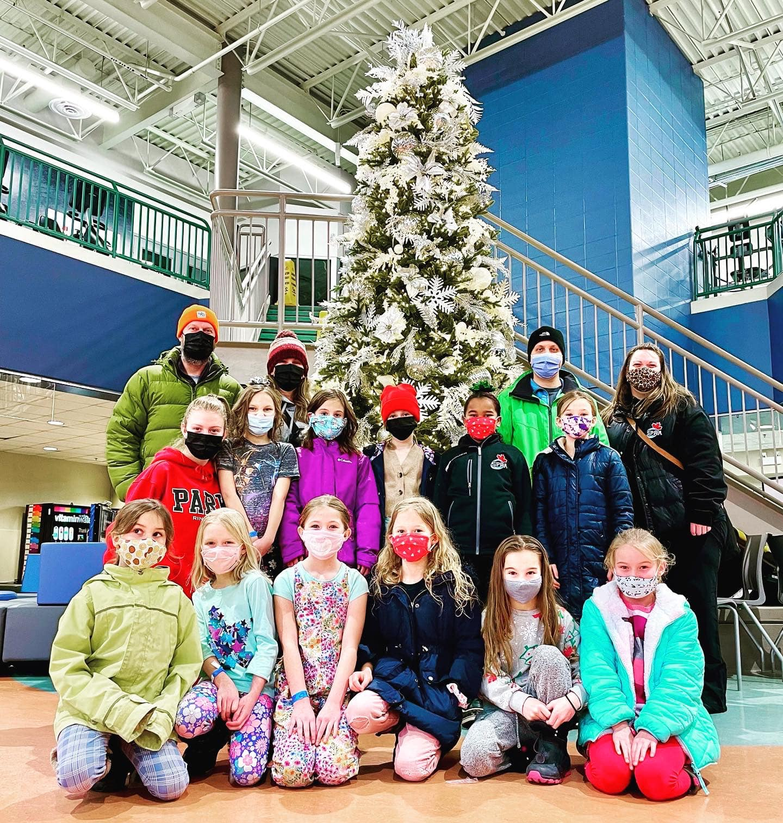
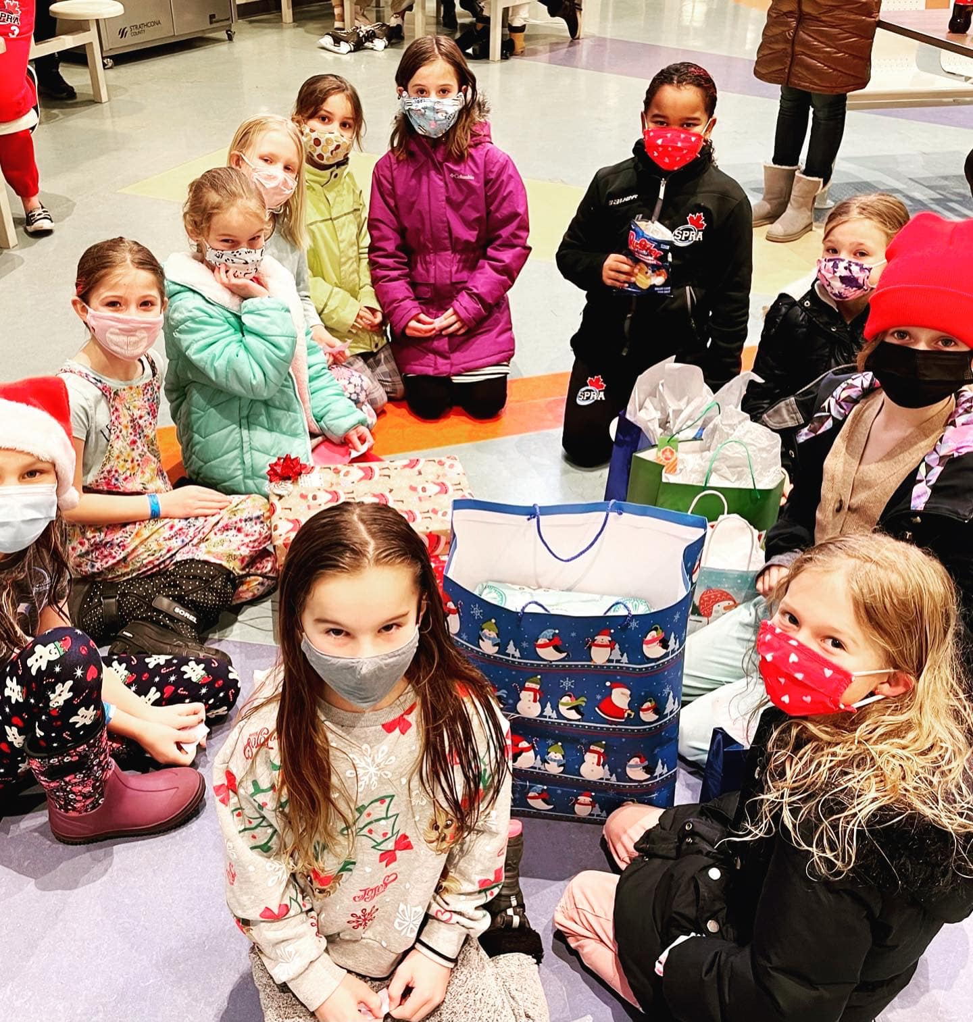
The U10 Step 2 Frogs 🐸 celebrating Christmas and all the joy it brings, with swimming and secret Santa! Happy holidays!

Slide 45
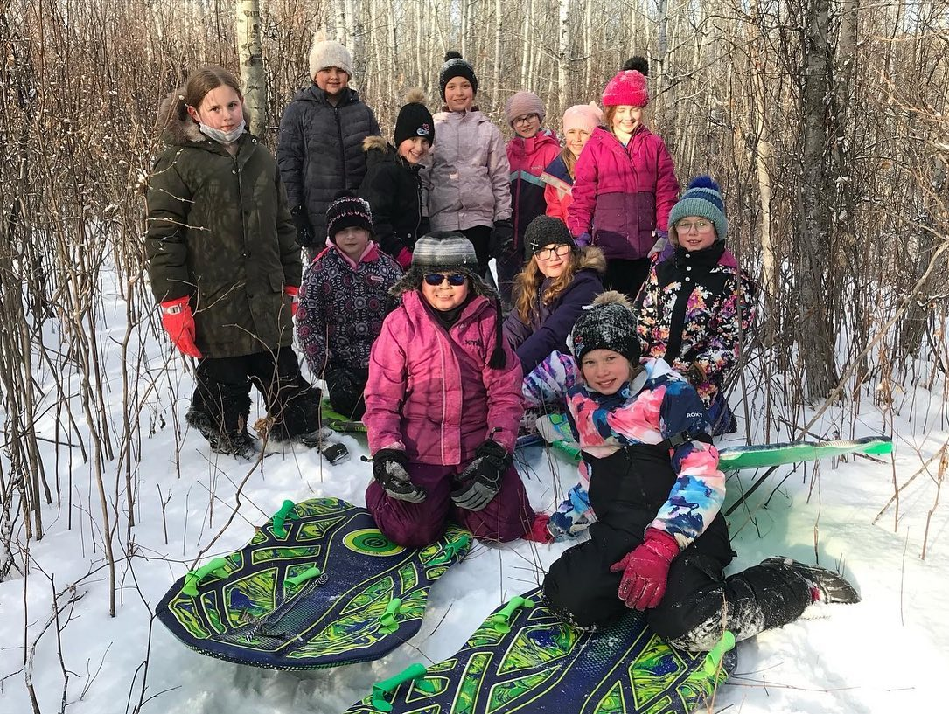
The U10 Step 3 Warriors had some fun tobogganing over the holidays!

Slide 46
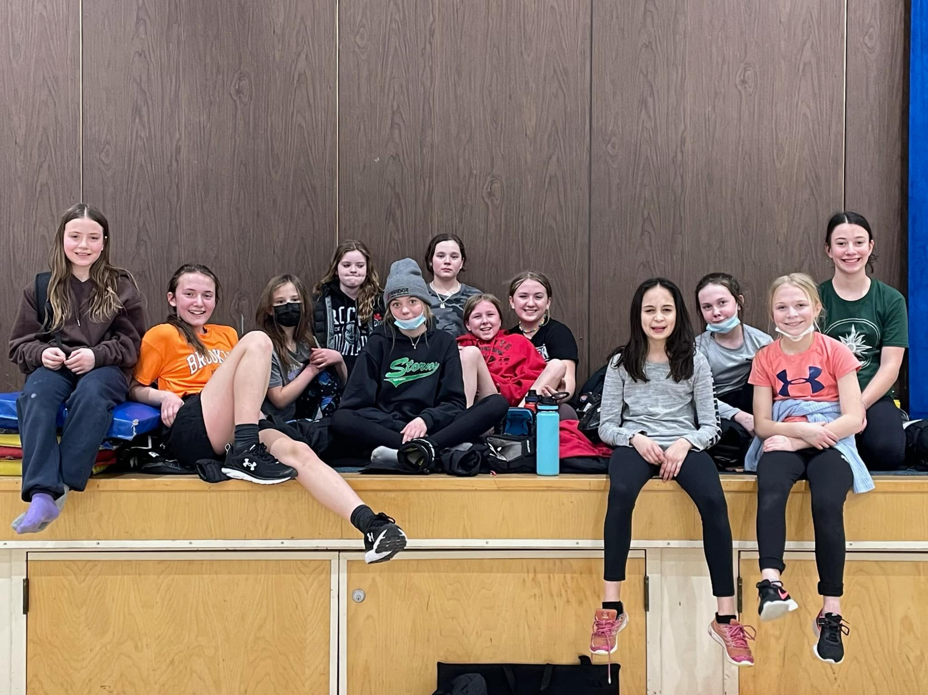
U12A Rage

Slide 47
U12A Terminators

Slide 48
U12B Cobras

Slide 49
U12B Venom

Slide 50
12A Terminators cheering on the Adrenaline!

Slide 51
U14A Venom
celebrating a great end to the regular season and provincial playdowns!

Slide 52
U14A Venom Survivor team challenges!

Slide 53
U14C Alpacas, some fun team building

Slide 54
U14AA Christmas team building

Slide 55
U16 ACE hit F45 for a killer workout - they #nailedit F45 Training Sherwood Park #spra

Slide 56
U16AA Power

Slide 57
U16A Adrenaline

Slide 58
U19A Park

Slide 59
U19B Fury

Slide 60
5 SPRA Players showing some #SPRAspirit on the ski hill!

Slide 61
U12A Rage
#cookiesforukraine

Slide 62
U14A Venom
#solidarity with Ukraine

Slide 63
U14B Blackout
#solidarity with Ukraine

Slide 64
Our U14B Stampede team, wearing their hearts and support on their sticks!!

Slide 65
U19AA/
U10 Santa Skate

Slide 66
#goaliefriends

Slide 67
Shiny new practice jerseys for the Stampede!

Slide 68
That’s a wrap for the U19B Fury! A fun season and lots of great memories along the way!!

Slide 69
U12 and Active Start siblings :)

Slide 70
The U10-Step 3 Warriors gave it all they had in the BGL U10 Windup final vs St.Albert and came out with the SILVER MEDAL!!
Way to go Warriors!! It was an incredible season!!!

Slide 71
And that’s a wrap for the U12A BGL ChampionshipsEnded with a Terminators vs Rage match up.

Slide 72
U12A Rage

Slide 73
U12A Rage

Slide 74
U12A
Terminators

Slide 75
U12A
Terminators

Slide 76
The U12B Venom had a great weekend at the BGL Championships in Red Deer. They ended their season with a win for 8/9th place against the Sherwood Park Cobras and won for best team video. Great season Venom!

Slide 77
U12B Venom and U12 B Cobras
BGL Championships!

Slide 78
U12B
Venom – A little friendly competition?☺

Slide 79
U12 and Active Start siblings :)

Slide 80
The U19AA Power are playing in the semi’s tomorrow 8 am in Leduc!! And they qualified for NATIONALS! Go Power!

Slide 81
The U19A PARK worked hard on provincial weekend to make it to the bronze medal match against Bow View Bruins. They came up a bit short but have a lot to be proud of. Great ringette weekend and thanks to all the great SPRA fans in the stands!!

Slide 82
U19A PARK

Slide 83
A battle for bronze. 16AA Power 4-3 over Calgary Matrix. Heading to Canadian Ringette Championships/Championnat canadien de ringuette April 3-9, 2022!

Slide 84
16A Adrenaline battled hard at the Provincial finals and came home with silver. Very proud of this great group of athletes.

Slide 85
U16 ACE played hard in #rabprovincials2022. The weekend was amazing - thanks to Pembina Ringette Association for hosting #greatjob
The team is so grateful these athletes and coaches got to compete this year and grow new friendships and make amazing new memories, so proud of you ACE!

Slide 86
U16 ACE #rabprovincials2022

Slide 87
The U16B Riot played hard and came away the winner of a giant candy basket for the heaviest food bank donation of 389lbs at provincials! Great work Riot!!

Slide 88
U16B ACE and RIOT
#rabprovincials2022

Slide 89
Congratulations to the U14A Venom on finishing sixth and showing you can play with the best in the province!! An amazing season and a fantastic team of players, parents, coaches, volunteers and fans!! Great weekend to end the season!!

Slide 90
U14A Venom #2022rabprovincials

Slide 91
U12 and Active Start siblings :)
U14A Venom
#2022rabprovincials

Slide 92
That’s a wrap for the U14B Blackout, placing 6th in Provincials. An outstanding effort by these young athletes against some very talented competition.
Congratulations Blackout! You should be very proud of yourselves!!

Slide 93
U14B Blackout #rabprovincials2022

Slide 94
Well, the #spra Alpacas are almost signing off on this wonderful season!! They didn't medal at #rabprovincials2022 but they stole the show! This team was a great come from behind story at the beginning of the year and thanks to the very committed parents, coaches and players they finished the year strong and took it to provincials.

Slide 95
Alpacas!!

Slide 96
Big congratulations to Open A 6 time Provincial champions Last Call! Shout out to their SPRA coaches Tarin O’Hara and Kari Sadoway who also play on the team!

Slide 97
The Rage played hard in Open B Provincials!!
#rabprovincials2022

Slide 98
SPRA was proud to host the 2022 AA Provincials. Lots of great competition and fun for all. A big thank you to the organizing committee! It was great to be back!

Slide 99
First ever Ringette Week in the County!

Slide 100
U12 and Active Start siblings :)

Slide 101
U14AA Power are so excited to be headed to Western Canadian Ringette Championship’s in Regina and to be chauffeured there. Good luck Power!

Slide 102
U16A Adrenaline and U14AA Power got ready for Westerns with a shared practice followed by a hard fought game. Both teams are so excited to represent SPRA at the 2022 Western Canadian championship in Regina.

Slide 103
Good luck to the U14AA Power in the semi finals tomorrow morning! They had some support for their last game from the U16A Andrenaline!

Slide 104
Congratulations to the U14AA Power on their silver medal at Western Canadian Ringette Championship’s! Nice work team!! And a big thank you to Regina Ringette Association for hosting!!

Slide 105
The U16A Andrenaline are the Western Champions!! Congratulations 🎉 Andrenaline! They’d like to say a big thank you to their fans for all of the support and to their coaches, team volunteers and parents for a fantastic season!
Thank you Regina Ringette Association for hosting a great Western Canadian Ringette Championship event!

Slide 106
Congratulations to these two U16A Adrenaline players who were named to the Western Allstars team based on their amazing performance this past weekend at the Western Canadian Ringette Championship’s! Way to go!

Slide 108
Good luck to the U16AA Power in the semi-finals!! They play at 4 today! Let’s go! Canadian Ringette Championships

Slide 109
Congrats to the U16AA Power! 4th in the country is pretty amazing! Enjoy the closing ceremonies! Canadian Ringette Championships #spra

Slide 110
U16AA Power Canadian Ringette Championships

Slide 111
It’s been a fantastic week of ringette for U19AA Power finishing 4th in the country out of 18 teams! Amazing heart, husle and talent. Congrats to Kaeli Woodlife named as U19AA first line goalie for the National All Star Team!! #crc2022

Slide 112
U19AA
Power
#crc2022

Slide 113
U19AA Power #crc2022

Slide 123
BROUGHT TO YOU BY:

